Slide 1
Markov Chains
Part 2

Slide 2
Bernoulli Trial
Bernoulli Trial: An experiment with 2 outcomes repeated n times
Two outcomes called S (success) and F (failure)
Set p = P(success) and q = 1-p = P(failure) (p and q are fixed)
Example: Flip a coin 20 times. Call H to mean success. Find:
P(20 S)
P(20 F)
P(6 S)
Theorem: P(k S’s) = C(n,k) p^{k} q^{n-k} where C(n,k) = n! /(ccc (n-k)! K! )

Slide 3
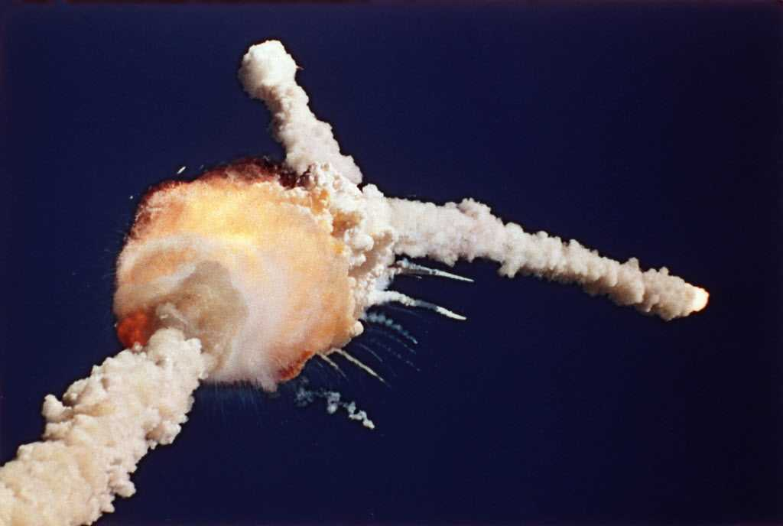
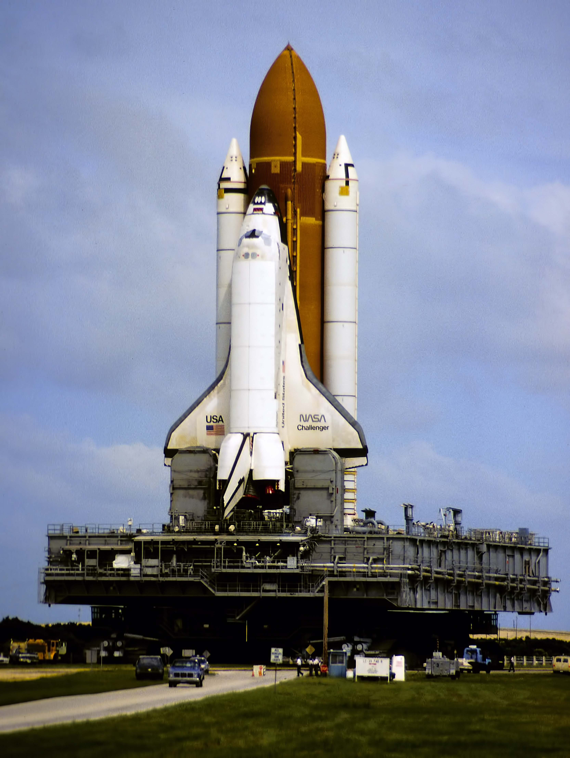
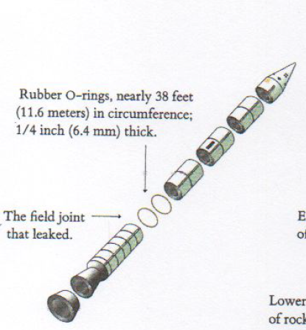
Bernoulli Trial Sidebar
On January 18, 1986 the Space Shuttle Challenger
was destroyed shortly after take-off. An O-Ring on
one of the booster rockets failed and caused an
explosion. The entire crew was killed.

Slide 4
Bernoulli Sidebar (2)
Example:
Space Shuttle launch is a Bernoulli trial. Assume that the probability of a successful launch is 97.3%, i.e. p = 0.973. Since Challenger was the 25th launch, find P(25 S in a row).
What is the probability that the 25th launch will be successful?
What if p = 99.9%? Find P(25 S), P(100 S), P(500 S)

Slide 5
Markov Chain
Set of n states, S = {s₁, s₂,...,s_{n}}.
Probability to move from state s_{i} to s_{j} is p_{ij}
This probability does not depend upon which states the chain was in before the current state.
The probabilities p_{ij} are called transition probabilities and they are summarized in the transition matrix.
The process can remain in the state it is in with probability p_{ii}.

Slide 6
Markov vs Bernoulli
Bernoulli:
2 states, fixed probability of success
Markov
N states, probability of next step depends on current state
So, a Bernoulli trial is indeed a (simple) Markov chain, but Markov chains are usually not Bernoulli trials

Slide 7
Example: Land of Oz
They never have two nice days in a row.
If they have a nice day, they are just as likely to have snow as rain the next day.
If they have snow or rain, they have an even chance of having the same the next day.
If there is change from snow or rain, only half of the time is this a change to a nice day.

Slide 8
Transition Matrix for the Land of Oz
 | R | N | S
R
N
S

Slide 9
2-Day Forecast for the Land of Oz
We consider the question of determining the probability that, given the chain is in state i today, it will be in state j two days from now.
We denote this probability by p_{ij}⁽²⁾ .
We see that if it is rainy today then the event that it is snowy two days from now is the disjoint union of the following three events:
it is rainy tomorrow and snowy two days from now,
it is nice tomorrow and snowy two days from now, and
it is snowy tomorrow and snowy two days from now.

Slide 10
2 Day Forecast Probabilities
We have:
p₁₃⁽²⁾ = p₁₁ p₁₃+ p₁₂ p₂₃ + p₁₃ p₃₃
and so forth, so that:
Theorem: Let P be the transition matrix of a Markov chain. The ij-th entry p_{ij}^{(n)} of the matrix P^{n} gives the probability that the Markov chain, starting in state s_{i}, will be in state s_{j} after n steps.

Slide 11
How to compute P^{n}

Slide 12
6-Day Forecast for Land of Oz

Slide 13
Pizza Delivery Example
A pizza delivery boy is attempting to deliver a pizza five blocks to a house. Every block he has a 50% chance of moving to the next block, he gets stuck in traffic with the probability of his current block (i.e. 1/10 for block 1, 2/10 for block 2, etc.) and the remaining probability that he losses his way and goes back a block (this is one stupid delivery boy). What is the probability that in ten steps he will deliver the pizza? How about in 20 steps?

Slide 14
Pizza Delivery Example

Slide 15
Pizza Delivery Example – transition matrix

Slide 16
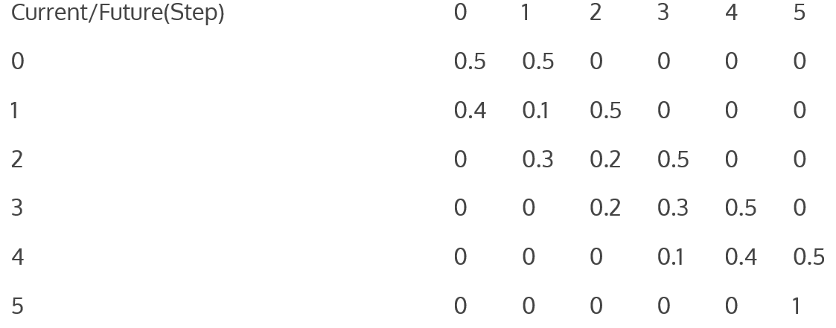
Pizza Delivery Example

Slide 17
Pizza Delivery Example
Once we have a probability matrix, we need to generate a step vector. A step vector is the probability that at a given step the delivery boy will be in a given block. Mathematically:
S0 = initial step vector = [1, 0, 0, 0, 0, 0] S1 = initial + 1 step vector = [0.5, 0.5, 0, 0, 0, 0] = = S0 * (Probability Matrix)
S2 = S1 * (Probability Matrix)
…

Slide 18
Will we get Pizza?
Start with s = <1, 0, 0, 0, 0, 0>. Find s = s P n-times.

Slide 19
Example: Drunkard’s Walk
A man walks along a four-block stretch of Park Avenue:
If he is at corner 1, 2, or 3, then he walks to the left or right with equal probability. He continues until he reaches corner 4, which is a bar, or corner 0, which is his home.
If he reaches either home or the bar, he stays there.

Slide 20
Transition Matrix for Drunkard Walk
 | 0 | 1 | 2 | 3 | 4
0
1
2
3
4

Slide 21
Where will we end up?
If we start at corner 1, will we end up in bar or at home?
Do the same for starting at corner 3 and 4
Where will I end up if I start at home? How about in the bar?

Slide 22
What is the long-term transition matrix

Slide 23
Transient vs Absorbing
Definition: A state s_{i} of a Markov chain is called absorbing if it is impossible to leave it (i.e., p_{ii} = 1).
Definition: A Markov chain is absorbing if it has at least one absorbing state, and if from every state it is possible to go to an absorbing state (not necessarily in one step).
Definition: In an absorbing Markov chain, a state which is not absorbing is called transient.

Slide 24
Questions to Ask about a Markov Chain
What is the probability that the process will eventually reach an absorbing state?
What is the probability that the process will end up in a given absorbing state?
On the average, how long will it take for the process to be absorbed?
On the average, how many times will the process be in each transient state?

Slide 25
Example: Running for Election
The President of the United States tells person A his or her intention to run or not to run in the next election. Then A relays the news to B, who in turn relays the message to C, and so forth, always to some new person. We assume that there is a probability a that a person will change the answer from yes to no when transmitting it to the next person and a probability b that he or she will change it from no to yes. We choose as states the message, either yes or no.
Let a = 0 and b = 1/2. Find P, P², and P³. What would P^{n} be? What happens to P^{n} as n tends to infinity? Interpret this result.

Slide 26
Transition Matrix

Slide 27
Transition Matrix after n Steps

Slide 28
Example: Elite Colleges
In the Dark Ages, Harvard, Dartmouth, and Yale admitted only male students. Assume that, at that time:
80 percent of the sons of Harvard men went to Harvard and the rest went to Yale
40 percent of the sons of Yale men went to Yale, and the rest split evenly between Harvard and Dartmouth
of the sons of Dartmouth men, 70 percent went to Dartmouth, 20 percent to Harvard, and 10 percent to Yale

Slide 29
Transition Matrix

Slide 30
Transition Matrix after n steps

Slide 31
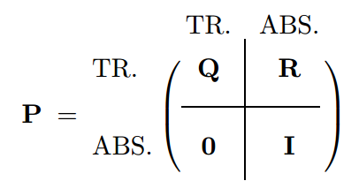
Canonical Form
Consider an arbitrary absorbing Markov chain. Renumber the states so that the transient states come first. If there are r absorbing states and t transient states, the transition matrix will have the following canonical form.
Here I is an r-by-r indentity matrix, 0 is an
r-by-t zero matrix, R is a nonzero t-by-r
matrix, and Q is an t-by-t matrix. The first t
states are transient and the last r states are
absorbing.

