Slide 1
The underpayment of restricted players in north American sports leagues

Slide 2
Background
What is the Reserve Clause in sports? –Now vs. 1970s
Experience-dependent: Journeymen vs. apprentices
Survey of the MLB, NFL, NBA: Surplus to owners!

Slide 3
History of study
Gerald Scully
Anthony Krautmann
MRP by separating MP and MR
Issues: Player MP can be very interdependent. MR doesn’t account for fixed revenues, like TV contracts.
Free agent wages=MRP
Competitive bidding=efficient player allocation
Does not care where value comes from (fixed or otherwise)

Slide 4
Methodology
Wage equation
MRP equation
Surplus equation
Expected performance by sport
Starters vs. utility

Slide 5
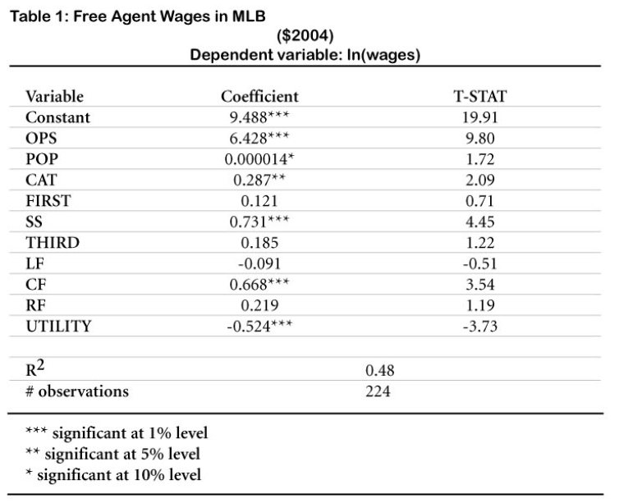
MLB
OPS (expected performance) tied to pay strongly
Utility players get paid less
Apprentice less than 20% of MRP, journeyman 80%

Slide 6
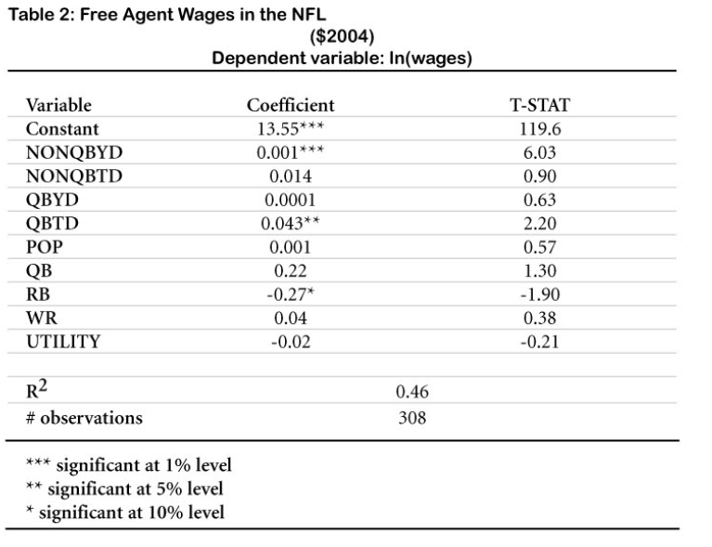
NFL
Only offensive players evaluated
Different definition of starters because of subbing in football
Apprentice gets 50% MRP, journeyman 75%

Slide 7
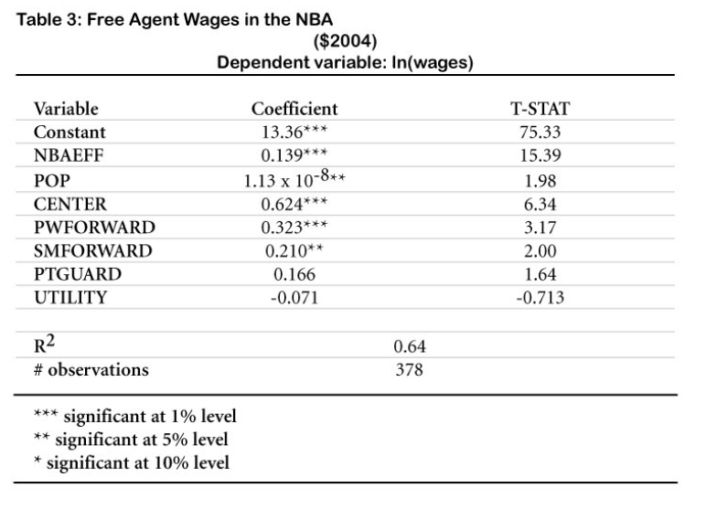
NBA
NBA EFF used as performance metric (includes position differences)
Most apprentice players bound to CBA contract amount per draft pick
Apprentices 66% of MRP
Rise in salary 300% for 2 std dev from mean point

Slide 8
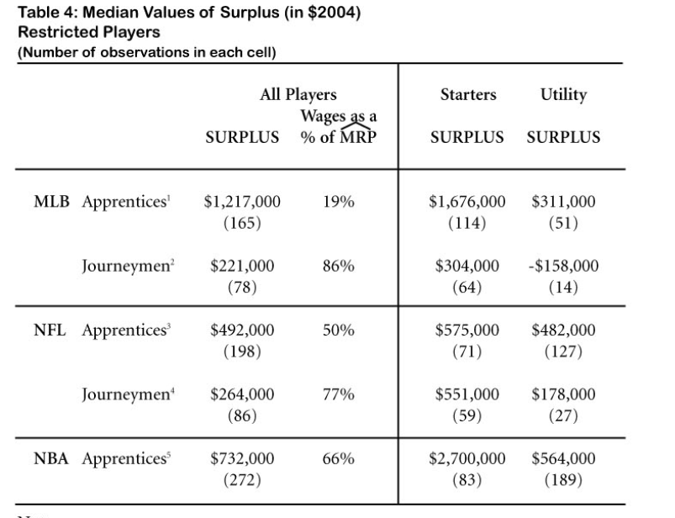
SURPLUS

Slide 9
Questions?

