Slide 1
The Effect of Professional Sports on Earnings and Employment in the Services and Retail Sectors in US cities
By Dennis Coates and Brad Humphreys
Presented by: Mary Bonatakis

Slide 2
Purpose of the Study
To explore the impact of professional sports teams and stadiums on employment and earnings in specific sectors in US cities. Explaining the negative total economic impact of sports.

Slide 3
Pros/Cons before research
Pros
Potential increases in employment, income, other benefits
Receive substantial government subsidies
Cons
Spending and income are limited
Spending on sports substitute for spending on other types of entertainment and goods
Notes:
Stadium advocated will argue that new teams and stadiums will drive up the money spent on food and beverages, hotels, and consumer items (souvenirs and team paraphernalia) will drive up the need for employees in the area
Anti stadium – substitute going to sporting events for movies, eating out, bowling etc. having a negative effect.

Slide 4
Overview
The relationship between the sports environment and the employment and earnings of workers in those sectors
Linking the sports environment to, eating and drinking establishments, hotels and lodging, amusements and recreation, and broad service and retail sectors
Professional sports fall under amusement and recreation, along with theaters, bowling, amusement parks, arcades etc.
This research will provide evidence that professional sports actually reduce local income
Notes:
If the pro-stadium argument is correct employment and earnings in each of these sectors should be higher with professional sports than with out it.
If the anti-stadium argument is correct then one might find decreases in the earning and employment at hotels, bars, etc.
Several previous studies found no evidence that professional sports teams, stadiums and arenas created jobs in the Metropolitan Statistical Areas – some found it increases jobs other found it increased – some found positive impacts on some sectors where others found negative – most do not take a closer look at these sectors

Slide 5
Sectors
The analysis focuses on the effect of professional sports franchises and stadiums on labor market activity in several specific sectors of the economies of US cities.
Taking a closer look at Services and Retail sectors, specifically:
Amusements and Recreation Services
Hotels and other Lodging Places
Eating and Drinking places
Notes:
When analyzing the data we have enough info to analyze the impact of professional sports on wages but not employment, in two sub sectors of the survives and retail sectors. Hotels and Eating and drinking places
Eating and drinking the most relevant- the idea that if you're going to a game you're going to stop at a local restaurant before or stay at a hotel

Slide 6
The Determination of wages and employment in local labor markets
t = indexes time
i = indexes MSAs
j = dependent variables of interest: wages in Services, Retail, Hotels, Amusements/Recreation, Eating/Drinking and employment in Services and Retail
X & Z = vectors of explanatory variables, capture the effect of two different types of factors on earnings and wages in the cities being samples.
X = the general economic climate in each city over a sample period
Z = captures the “sports environment” in each city and year
Notes:
The formula used
They first looked at liner reduced form models of determination of wages and employment take the general form above
Both vectors look at 37 cities that were home to professional football, basketball or baseball franchises currently or in the past 30 years
Solving for unknown parameters Bj and Yj for each dependent variable
This Regression chooses to exclude, on field success and attendance.

Slide 7
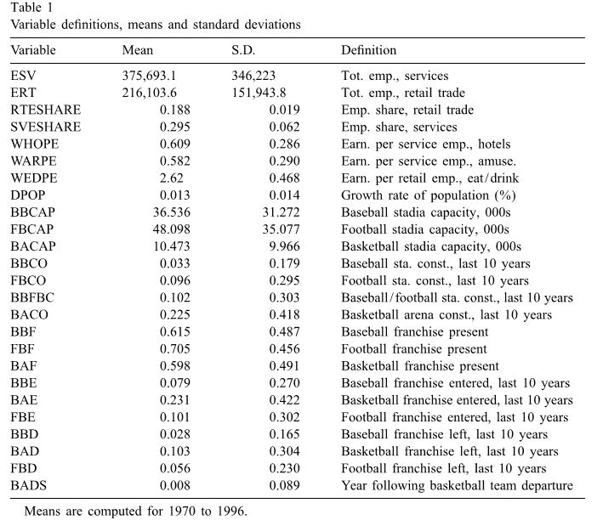
Notes:
Data used, looking at the three major sports, football, basketball and baseball

Slide 8
Results and Discussion
Looking at regressions form 7 different dependent variables:
Employment in the Service Sector
Employment in the Retail Sector
Wages per employee in Eating and Drinking Establishments
Wages per employee in hotels
Wages per employee in Amusements and Recreation
Retail share of total employment
Services share of total employment

Slide 9
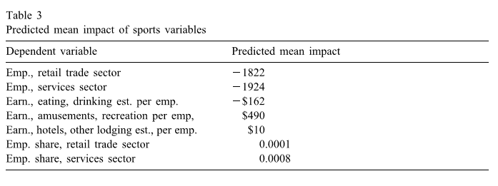
Notes:
Almost all have a negative correlation, net loss of over 1800 jobs in retail, 1900 in service etc. -> will rise in earning in amusement but this includes the players
Football teams have 53 person rosters – paying their team a lot more than a basketball (12) team/ baseball (25) team

Slide 10
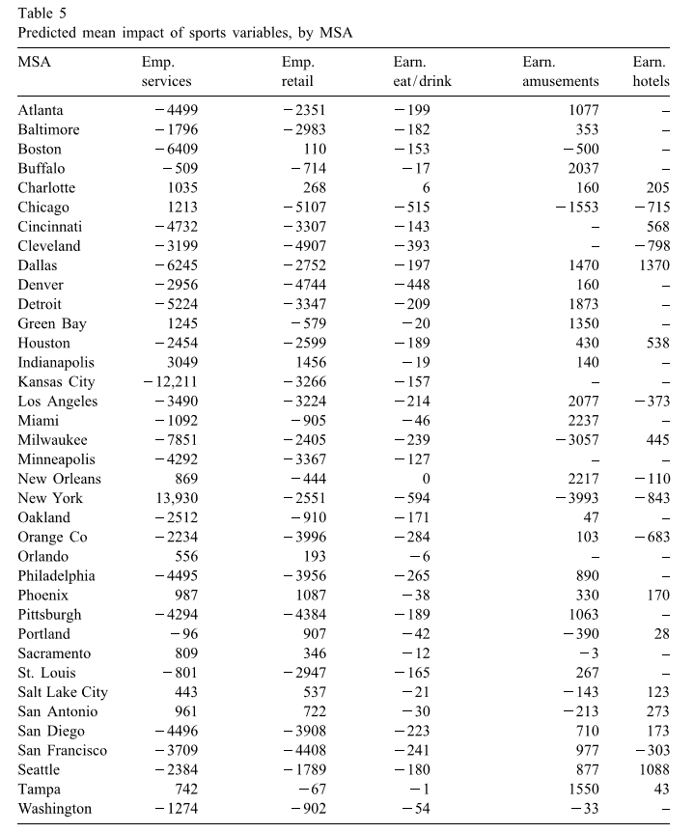
Notes:
Negative in 25 of the 37in services
Retail 28 of 37
Eat/ Drink 35 of 37
Amusement has a lot of positive because that’s where the sports fall under
Hotels 7 of 19 are negative

Slide 11
Quality Test
Dennis Coates and Brad Humphreys’ took into account how the dependent variables could make their regression bias and not accurate
In order to ensure their results were correct they ran several other test using alternative specifications of control variables.
After preforming these test they found very similar results, and there is only one specification that shows sports having generally positive effects on employment and earnings (this result suffers from omitted variable bias)

Slide 12
Conclusions
Professional sports has a small positive effect on the Amusement and Recreation sector, but this positive effect is offset by a decrease in both earnings and employment in other sectors.
The direct spending on sports does not lead to additional earnings in other sectors of the economy like restaurants, bars and hotels.
Spending on sports lead to a substitution in other related areas
Sheds a new light on the reason professional sports reduce the level of income in cities.

Slide 13
Thank you for listening! Questions?

