Slide 1
Sports Sentiment and stock returns
Gregory Gay

Slide 2
Overview
Written by Alex Edmans, Diego Garcia, and Øyvind Norli
Discussion
Mood Variable
How sport outcomes affect investors decisions in the stock market
International soccer is the primary focus

Slide 3
Mood Variable
Variable which takes into account the power sporting events have on people’s moods
Must Satisfy 3 Criteria
The variable must drive mood in a substantial and unambiguous way making its effect powerful enough to show up in asset prices
The variable must impact the mood of a large proportion of the population so it is likely to affect enough investors
The effect must be correlated across the majority of individuals within a country

Slide 4
Sample Size
International Soccer Sample
Matches played by 39 countries
1,162 games
638 wins
524 losses
Cricket, Rugby, Ice Hockey, and Basketball Sample
Matches played by 24 countries
1,550 games
905 wins
645 losses

Slide 5
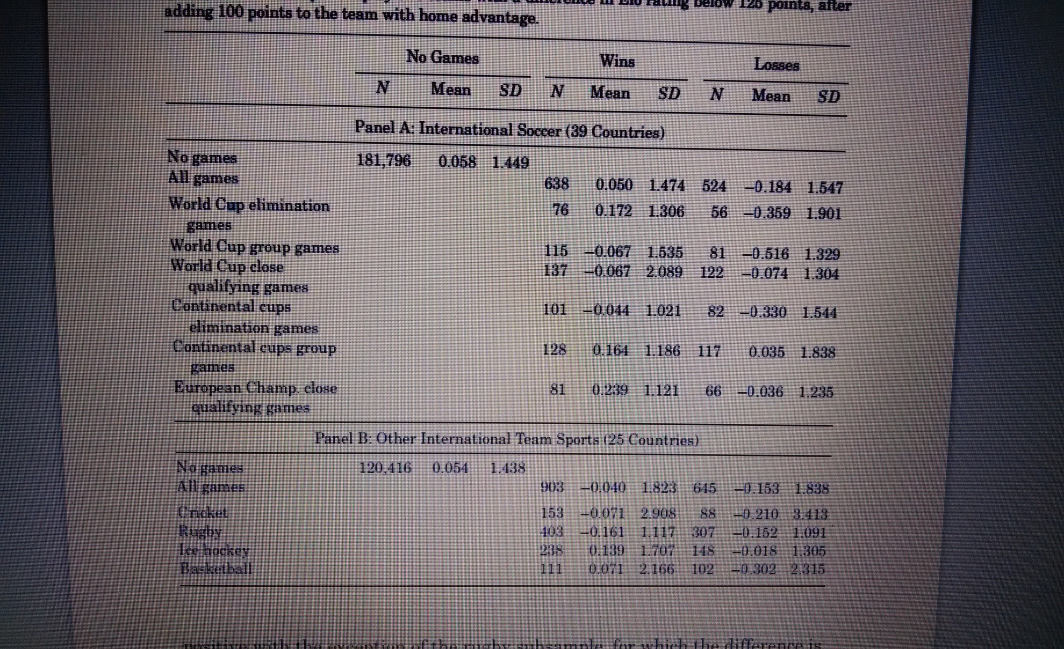
Results of the Sample

Slide 6
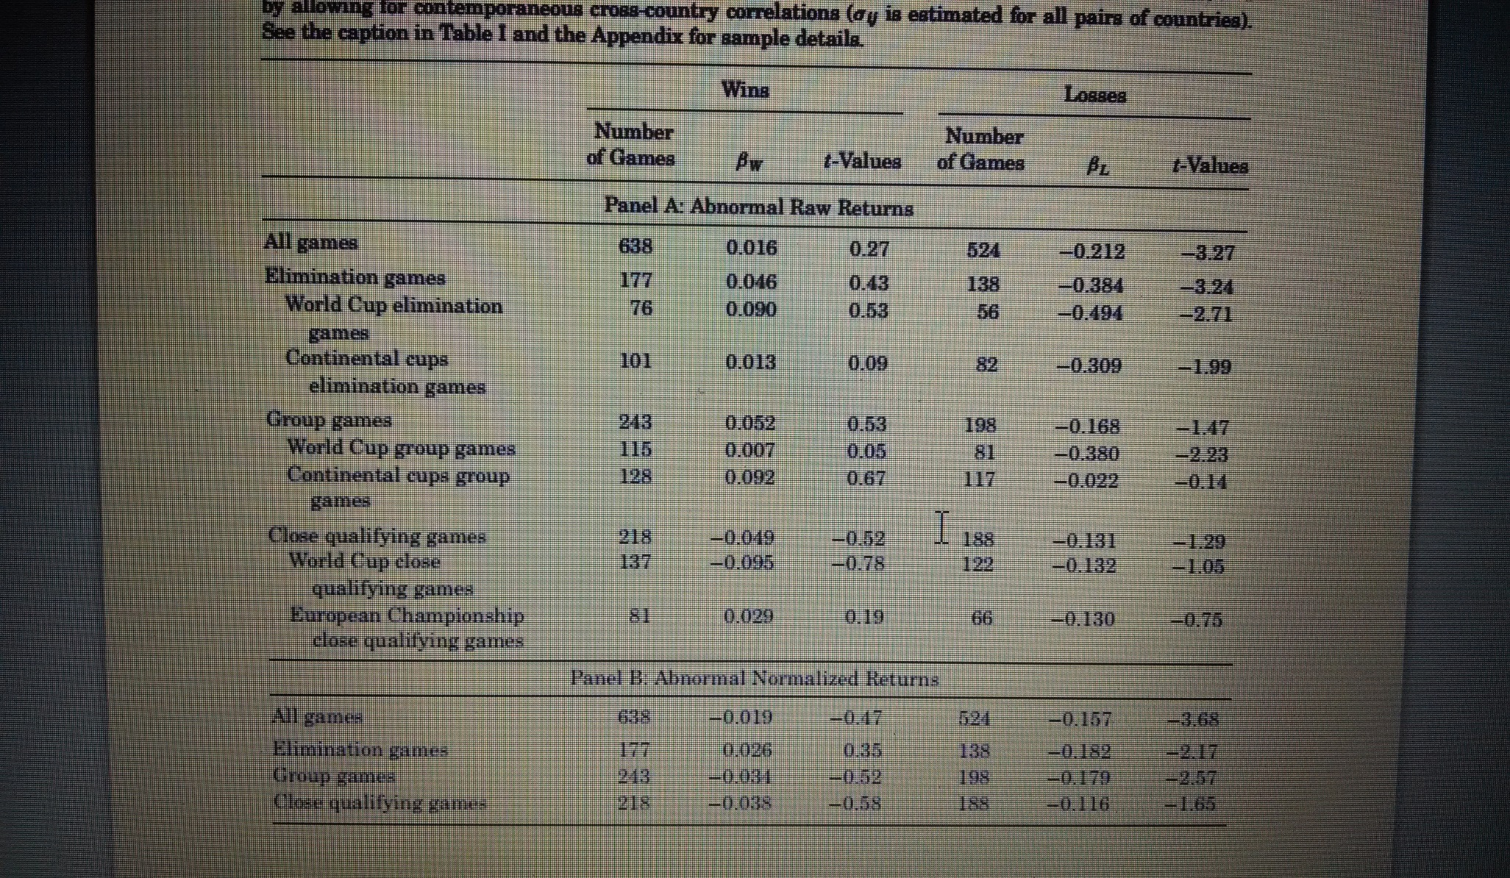
Soccer Effects

Slide 7
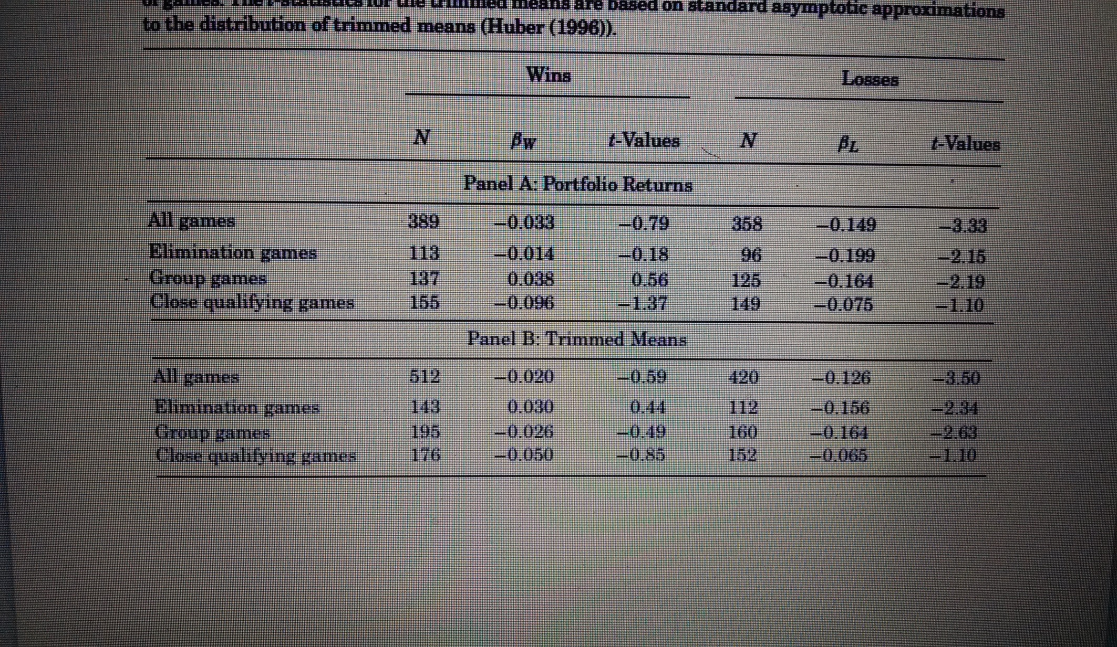
Soccer Effects Continued

Slide 8
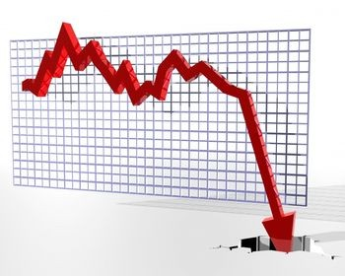
Conclusion
There is a noticeable loss effect in the losing team’s country market
Soccer has a larger effect on markets than any other sport internationally

