Slide 1
QUITTERS NEVER WIN: THE (ADVERSE) INCENTIVE EFFECTS OF COMPETING WITH SUPERSTARS
JENNIFER BROWN
PRESENTED BY KRISTEN A. ROTHE

Slide 2
INTRODUCTION
Tournament Theory
Competition → Effort?
Lack of data for corporate executives
Use of professional golf data
Previous studies of tournament theory

Slide 3
Key terms and Info
Golf Scoring
Eagle (-2) | Two strokes under par
Birdie (-1) | One stroke under par
Par (0) | Standard score for a hole
Bogey (+1) | One stroke over par
Double Bogey (+2) | Two strokes over par
Player Classification
Exempt: automatically qualify
Higher skilled
Non-exempt: must qualify
Tournament Rules
Four rounds in tournament (Thursday – Sunday)
Cut after second round
Top 70 golfers

Slide 4
Data
363 PGA Tournaments from 1999 to 2006
Location, par, yardage, player qualifications
Official World Golf Ranking (OWGR)
Match tournament scores with rankings
Tiger Woods’s performance
54 PGA wins from 1996-2006
High probability that will play very well

Slide 5
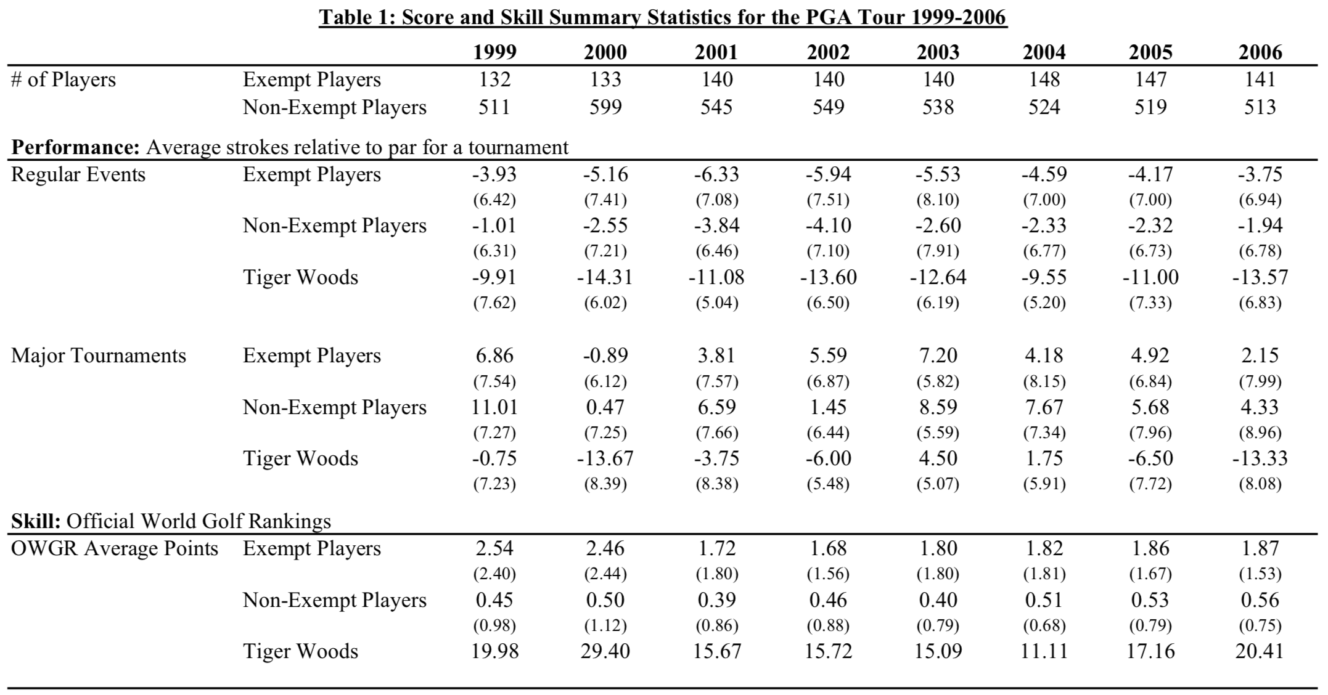
Higher scores and OWGR points for exempt players
Effect magnified with Tiger Woods
DESCRIPTIVE STATS

Slide 6
Superstar Presence

Slide 7
Regression
Strokes_{ij} = final score
Star_{j} = presence of superstar
Exempt_{i} = indicate exempt or non-exempt status
X_{j} = matrix of tournament and course-specific controls
Y_{i} = matrix of variables represening player attributes
β₁ – captures Woods’s impact on non-exempt players
β₁+ β₃ – captures Woods’s impact on exempt players

Slide 8
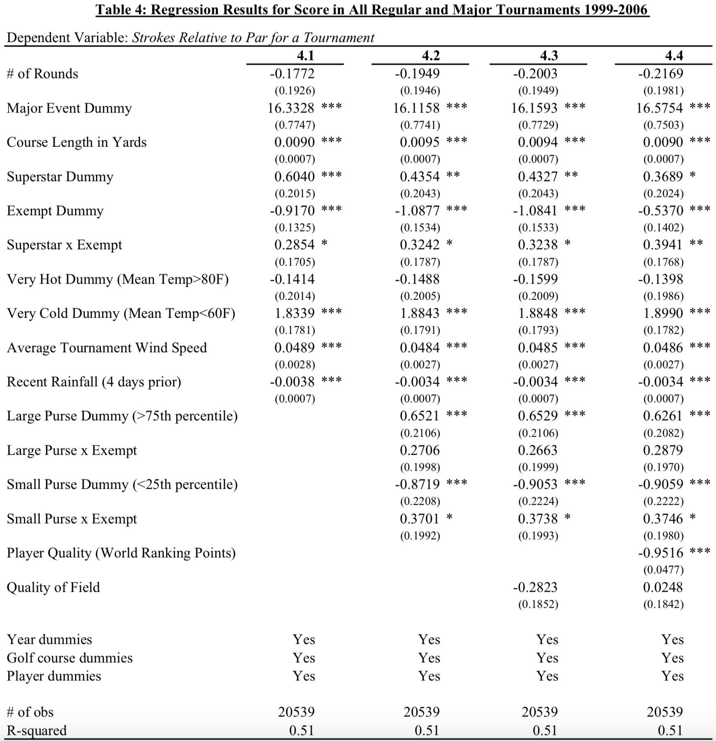
Regular and Major Tournaments
Regression 4.1
Exempt – 0.8 strokes higher
Non-exempt – 0.6 strokes higher
Regression 4.2
Control for purse size
Regression 4.3
Control for average quality of field of golfers
Regression 4.4
Allow golfers’ quality to vary across years

Slide 9
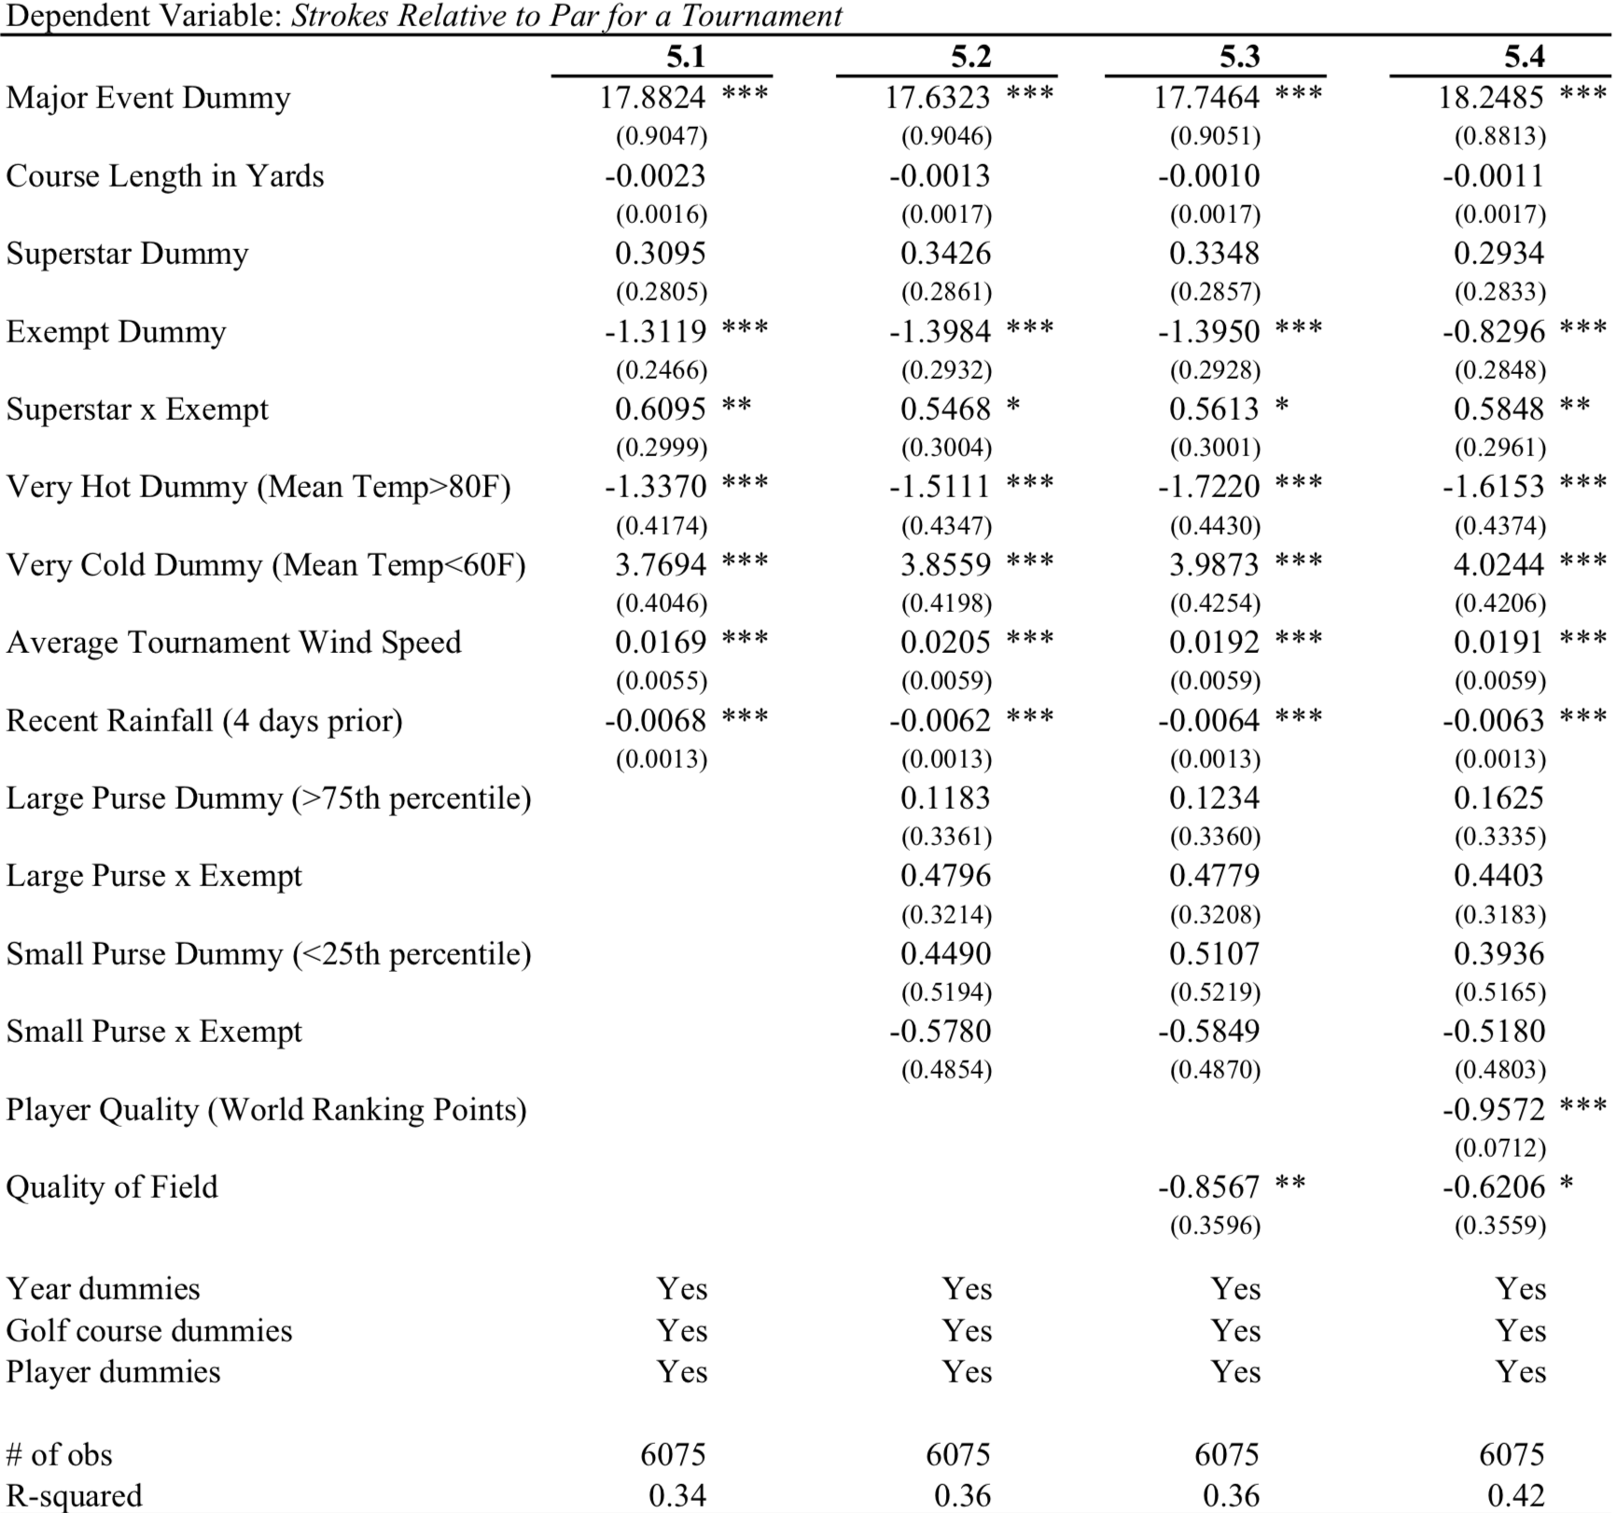
“Tiger-played” tournaments
Sampled narrowed to courses on which Woods has sometimes competed
Exempt – 0.9 strokes higher with Woods
Non-exempt – superstar effect “indistinguishable from zero”
Not too surprising

Slide 10
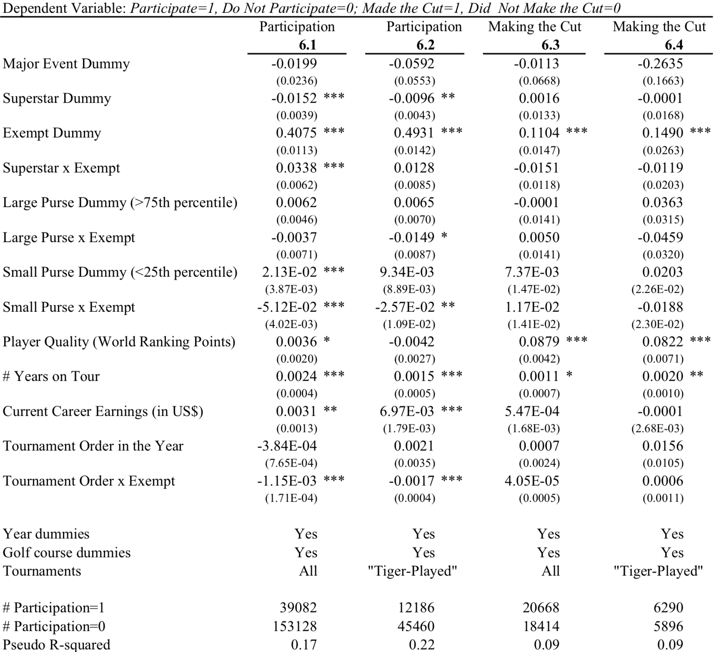
Tournament Selection & making the Cut
Do players avoid tournaments with Woods?
Exempt – 0-2% more likely to enter with Woods
Non-exempt – 1-2% less likely to enter with Woods
Selection bias does not drive superstar effect
Superstar presence – no effect on making the cut

Slide 11
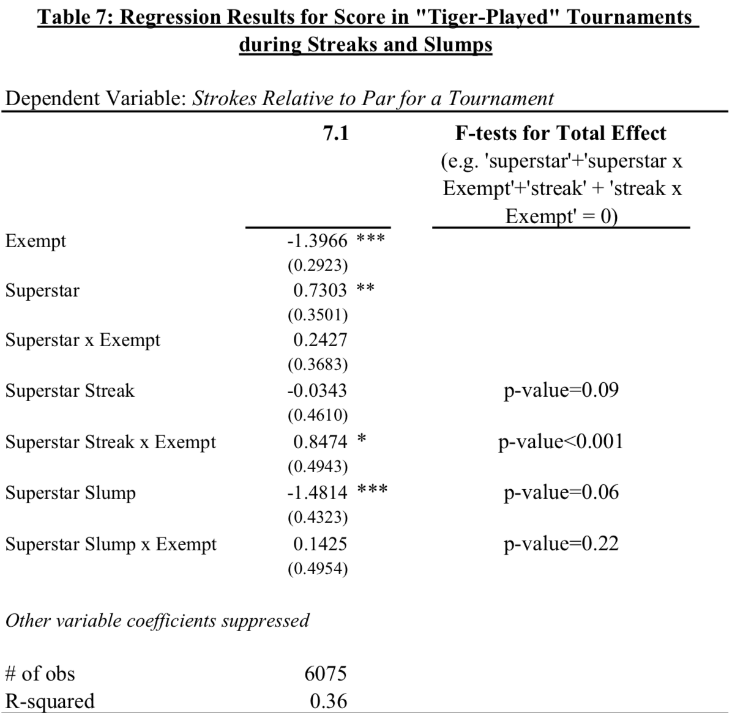
Streaks and SLumps
Estimate equation with streak and slump indicators
Typical play
Non- exempt – 0.7 strokes
Exempt – 1 stroke
Streaks
Exempt increases by approximately 0.85 strokes
Slumps
0.4 stroke improvement

Slide 12
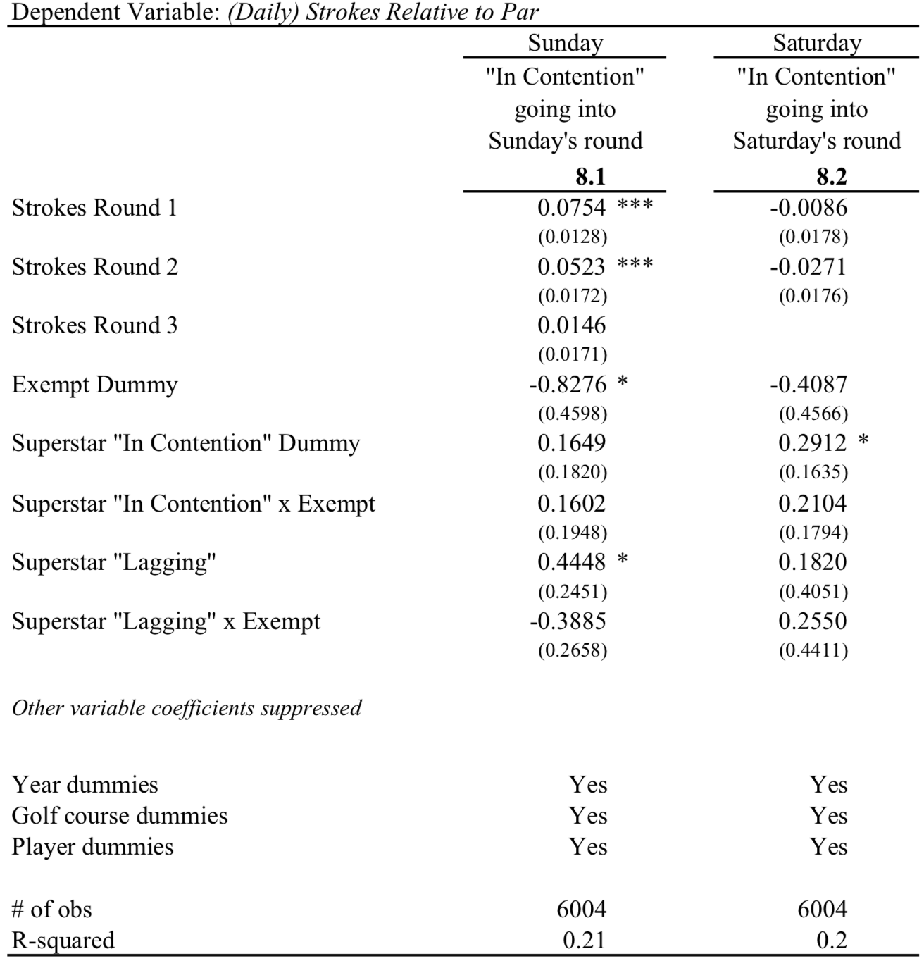
“In the hunt”
Similar streak and slump pattern within tournaments
Going into Sunday scores
Exempt – 0.32 strokes higher
Non-exempt – 0.16 strokes
Going into Saturday scores
No impact on competitor scores

Slide 13
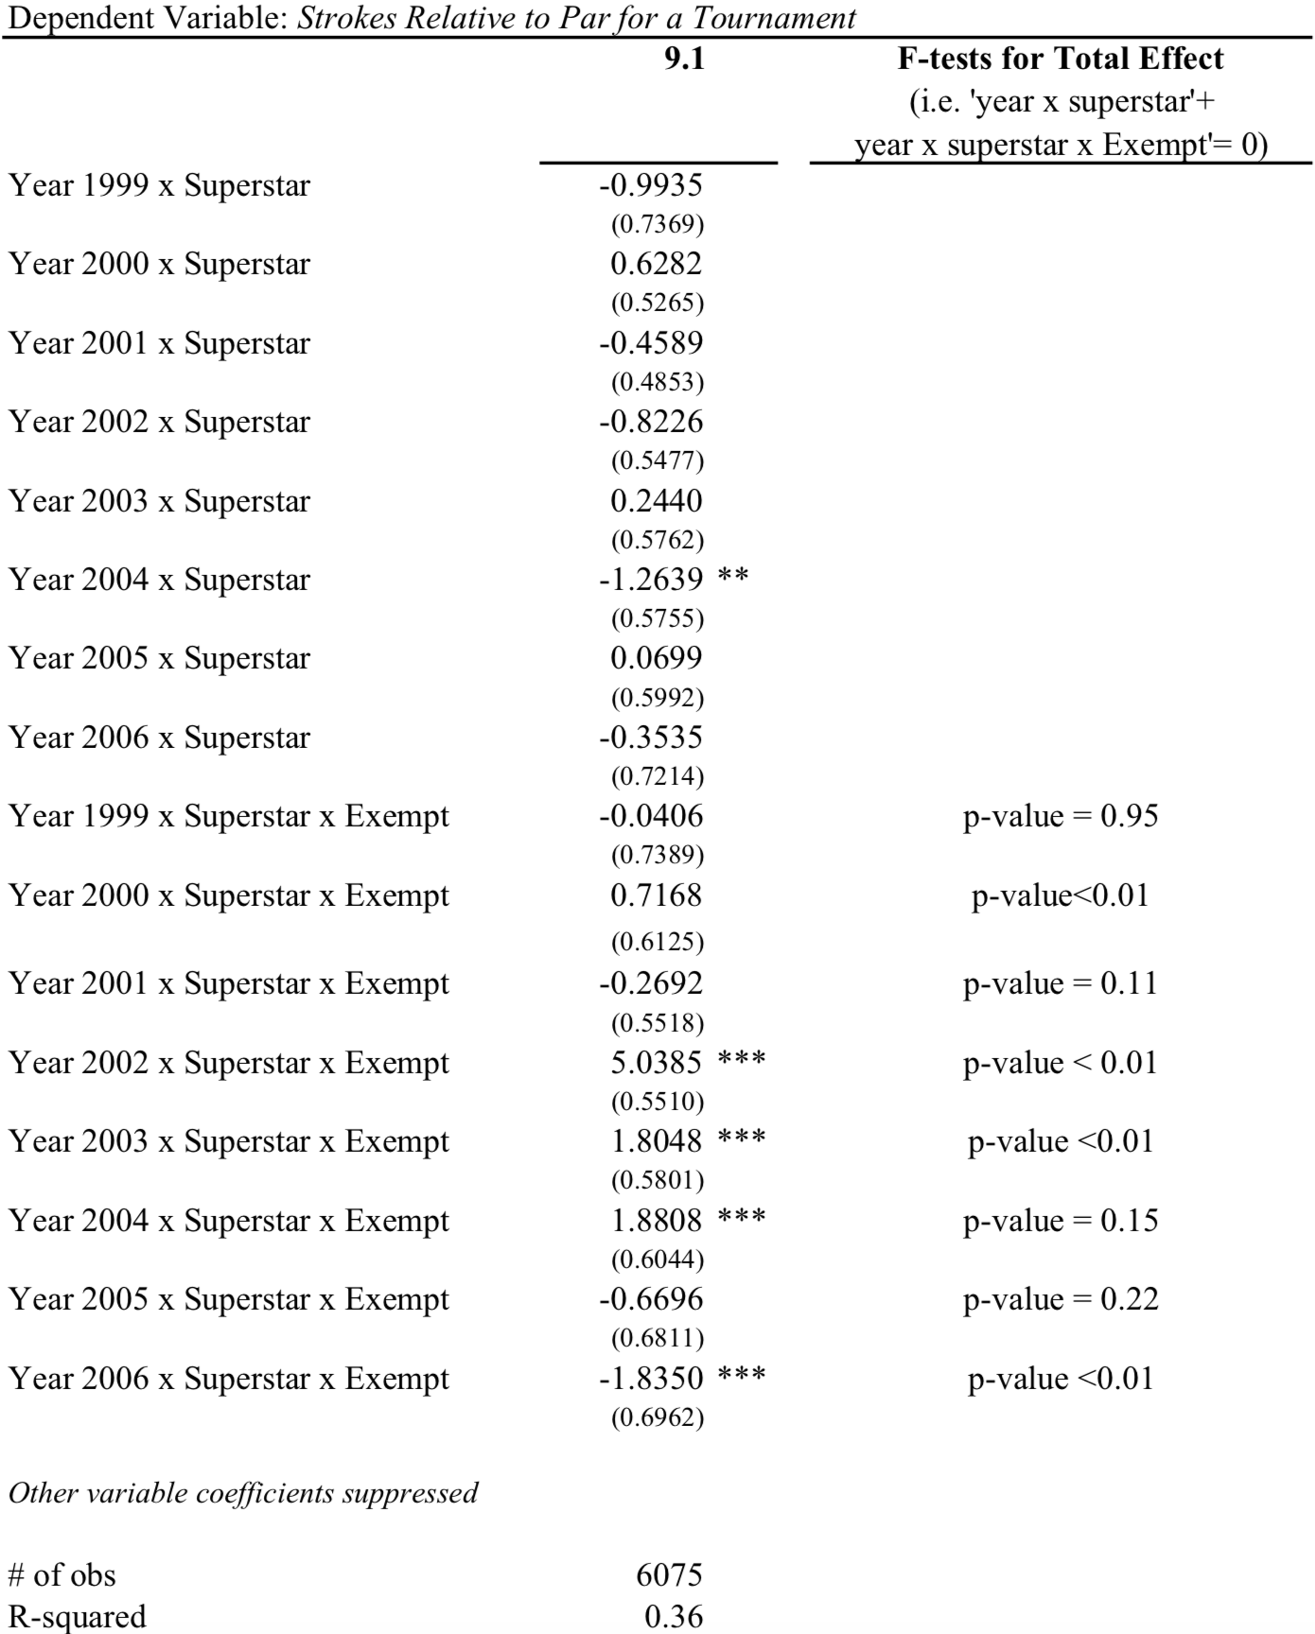
The “distraction” Factor
Superstar effect a result of increased media distraction?
Report the superstar effect by year
Should increase over time if distraction
Coefficients show no pattern of increase

Slide 14
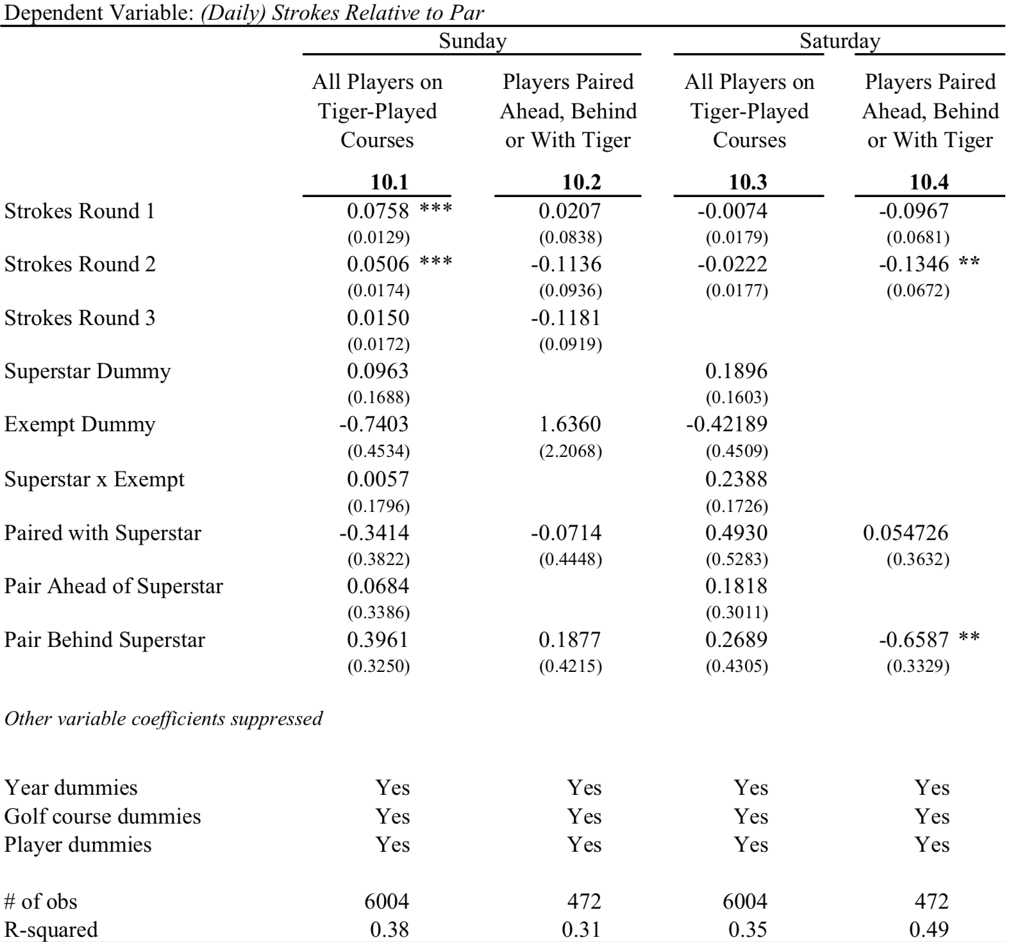
Scaring the competition
Is Woods’s intimidation a factor in superstar effect?
Saturday’s superstar effect for exempt players is 0.4 strokes
Expect to be more adversely affected

Slide 15
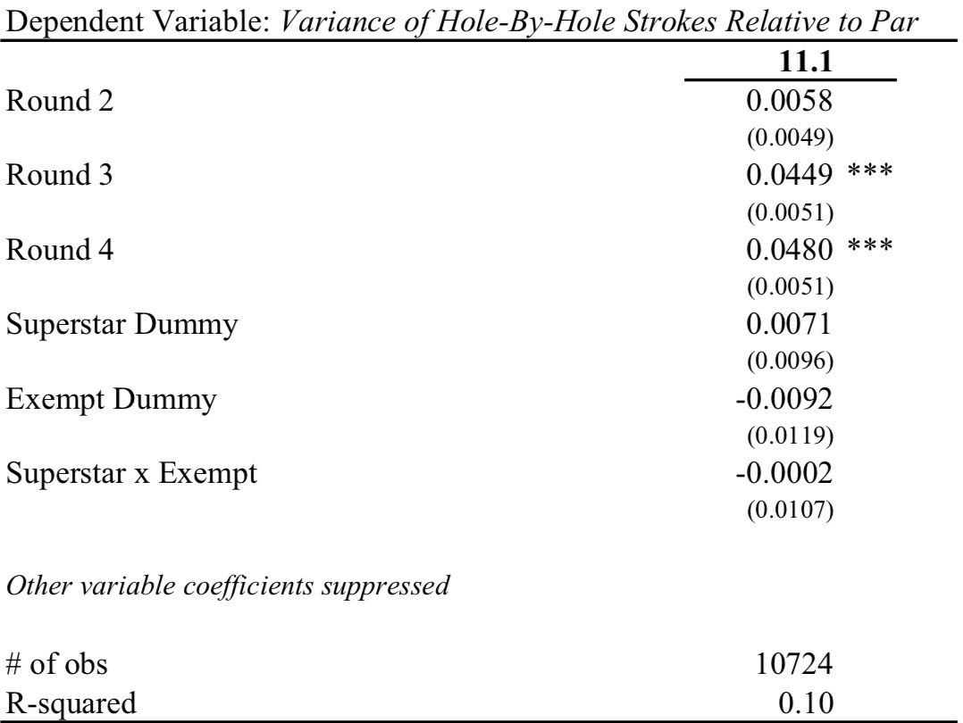
Risky Strategies
Riskier strategies with superstars?
Variance of hole-by-hole scores for “riskiness”
Little evidence that riskier play leads to superstar effect

Slide 16
In summary...
Superstar leads to reduced performance from other competitors in a tournament
Higher scores not a result of “riskier” strategies by competitors
Superstars must by “super” to create adverse effects

Slide 17
My thoughts
Loose definition of superstar
How long do you have to succeed to create effect?
Was there talent during Woods’s years?
How would this study work out today?
Does the effect work today with Woods?

