Slide 1
“If You Can’t Win, Why Should I Buy A Ticket?”: Hope, Fan Welfare, and Competitive Balance
Norm O’Reilly, Alan Kaplan, Ryan Rahinel, John Nadeau
Connor Lynch

Slide 2
Overview & Key Words
This paper analyzes the relationship between the goals of a firm/team in professional sports and its connection with the competitive balance.
CB = Competitive Balance
This paper first asserts that maximizing fan welfare is dependent upon the level of CB (hope) in the league.
Fan’s welfare is a function of the prospect of their team advancing to postseason play. “Hope” is an important dimension of fan welfare.

Slide 3
Five Sections
An acknowledgement of important concepts of CB
A discussion of the goal of the firm in the context of professional team sports and the role of CB in promoting this goal
A definition of a construct that may form the basis of a future metric to measure CB in line with a fan-welfare based goal to the firm
An empirical investigation of the hope construct to determine the resonance of the theoretical construct among fans and management
Conclusions and future suggestions

Slide 4
Important Concepts In Competitive Balance
Competitive Balance (CB): degree of uncertainty in the outcomes of competitive sporting events
Fan Welfare: overall level of fan satisfaction as determined by the benefits provided by the team
Different types of fans exist
Hope: dynamic and binary forecast for a team’s ability to engage in post-season play, made by customers of that team

Slide 5
The Goal of the Firm in a Professional Sports League – Part 1
What should be the goal(s) of the firm in a professional sports league?
Maximize team’s profits or maximize team’s winning percentage
Seems to be implied that owner welfare is incidental to fan welfare and the welfare of the owner is maximized when the interests of the fan are served
The objective is to show that maximizing fan welfare in a for-profit league environment is consistent with both maximizing shareholder and stockholder utility.
World War II & 9/11

Slide 6
The Goal of the Firm in a Professional Sports League – Part 2
At first glance, maximizing fan welfare serves neither to maximize shareholder wealth nor to maximize stakeholder utility.
To reconcile this apparent discrepancy, one of three steps is necessary:
Develop a different firm objective
Differentiate professional sports in some meaningful way from its profit counterparts
Show that maximizing fan welfare does indeed either maximize shareholder utility, stakeholder utility, or both.
This paper pursues the second and third alternatives and in doing so, supports the argument that maximizing fan welfare should be a goal.

Slide 7
The Need for CB to Promote Fan Welfare
Fan interest results from an increase in the uncertainty of outcomes
Uncertainty of Outcomes Hypothesis (UOH)
Gives equal weight to each game, regardless of team’s position/standings
Marginal Revenue for acquiring talent may be greater for some teams than for others, leading to a lack of competitive balance
An assumption is made that a positive relationship exists between fan welfare and CB

Slide 8
What Is Hope? Part 1
Some define CB as the measure of the UOH
Although, it is said that a proper CB will not exist until every well-run club has a regularly recurring hope of reaching postseason play
Hope is binary….as in it either exists or it does not
Hope is dynamic… which means that fans may either attain, lose, and regain hope as time passes and events occur (winning streaks, trades, etc.)
UOH, which is defined using CB is a continuous variable (low to high)

Slide 9
What Is Hope? Part 2
This paper argues that three types of behavioral outcomes occur in terms of the effects on the type of commitment that is invested:
Commitments at the game level (watching the next game on TV or buying tickets to the next game)
Commitments at the within-season level (watching the rest of the season on TV)
Commitments at the between-season level (buying season tickets for the next season)
Any attempt to measure fan welfare should measure each of these three outcomes.

Slide 10
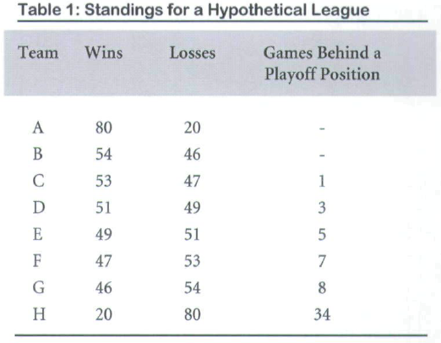

Slide 11
Table 1 Analysis
Eight team league in which each team plays 100 games
Two teams out of eight make the playoffs
The dominance of Team A translates into one less playoff spot for which the rest of the teams can compete
The presence of the dominant team would reduce CB (UOH)
Arguably, a dominant team could also increase CB because of the hope that the “hatred” dominant team can be defeated

Slide 12
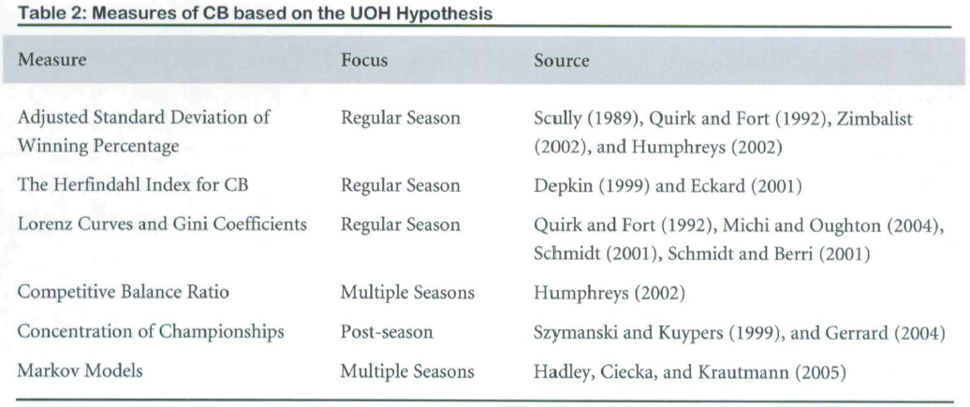

Slide 13
Two-Stage Method
A random sample survey was implemented during July of 2006 in a large urban center that is home to an MLB team (scored 1-5; disagree-agree)
A series of nine questions was constructed to measure the hope construct and whether respondents were consistent in their need for different types of hope, not just postseason play
Aimed to pinpoint when the average fan loses hope and to determine whether all or most fans tend to lose hope with criteria based on their team’s lag behind the performance leader.
It is argued that the GBL (game behind the lead) point at which a team management loses hope can proxy for the GBL point at which fans lose hope

Slide 14
Three Suppositions
Fans and team management are both equally knowledgeable and rational concerning their team’s prospects
Management’s decision to give up on a season is readily observable by fans and that fans will take it as a credible signal that management has “thrown in the towel”, in turn influencing fans to also give up hope
The manner in which management gives up (trade or release of a player who is a fan favorite, trades in which the team receives only cash or draft picks, etc.) may actually further impair the team’s chances

Slide 15
Method – Part 1
Trades were documented by management at or around the trade deadline in the MLB
Hypothesized that teams that traded for players with higher salaries than they received in return were doing so in order to increase their chances of making playoffs or winning a championship
The contrary for teams looking to rebuild
Thus, it is argued that net increased in salary can be used as a proxy for management hope

Slide 16
Method – Part 2
The data was then analyzed to determine if there was strong empirical support linking management’s trading behavior with their GBL
Data includes trades between 6/1/2006 and 7/31/2006 in MLB
Factors Considered
Date of each trade, the particulars of each trade (player names, cash, etc.), the number of GBL, & teams net increase/decrease in salary incurred by the trade
Teams that incurred net increases of salary because of the trade were given a value of “1” while teams that incurred a net decrease were given “2”

Slide 17
Goal of Observation
To confirm whether management traded away salary when the team was “X” games or more out of a playoff spot at or around the trade deadline or traded into salary if the team was “X” games or less out of a playoff spot
To confirm whether the behavior was universal or close to universal for all teams

Slide 18
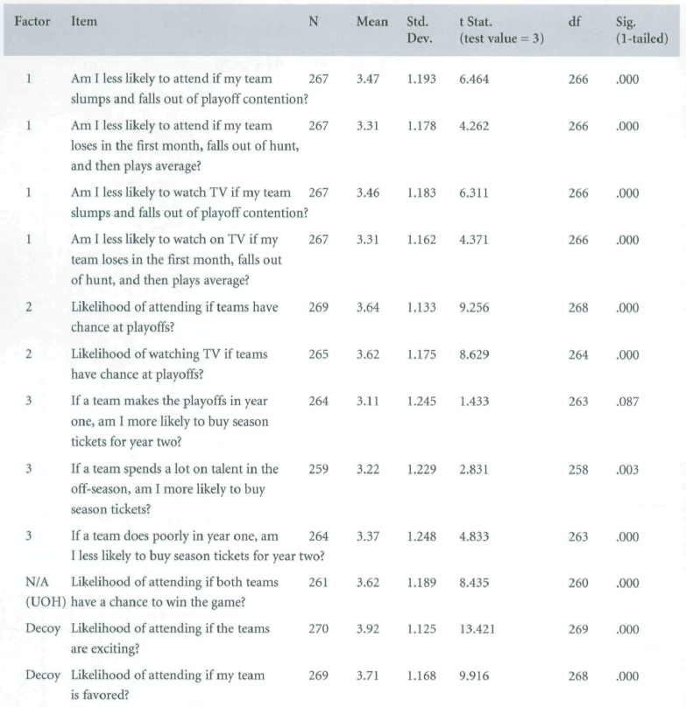
Results Part 1: Random Sample Mass-Market Survey

Slide 19
Results Part 1: Random Sample Mass-Market Survey

Slide 20
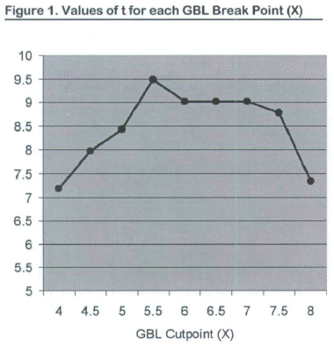
Results Part 2: Trade Analysis

Slide 21
Results
The combined factor analysis and the underlying survey results support the hypothesis that the hope for post-season play is another factor in driving fan interest
The t-statistics lend strong support to the hypothesis that team management does trade away salary (give up hope) when the team is “X” or more GBL and takes on salary when it is fewer than “X” GBL. Also, although it is not conclusive the consistency of the results suggests that managers of most teams behave similarly.

Slide 22
Conclusions
Maximizing fan welfare is a legitimate goal of the firm, based on common goals utilized by for-profit firms most often propounded in the literature
“Hope of post-season play” is related to fan interest
Hope is adequately conceptualized as a binary construct implemented through GBL breakpoints
In contrast to some of the CB literature, findings suggest that the number of teams (relative to number of teams in the league) reaching the post-season every year is related to far welfare

Slide 23
Conclusions
The results also suggest that the dispersion between those teams that might continue to post-season play and those teams that will clearly not is also important
The role of the trade deadline has also been underscored
The results indicate that “hope” represents or stimulates a level of engagement with the sport and league that is desired
A next step is to develop a measure of CB based on hope and empirically measured over time and to test whether this metric more effectively explains the relationship of CB and attendance

