Slide 1
The Effects of Roster Turnover on Demand in the NBA
Alan L. Morse, Stephen L. Shapiro, Chad D. McEvoy,
and Daniel A. Rascher
Presented by: Kelly Dallavalle

Slide 2
About the Authors
Alan L. Morse
Doctoral student in sport finance and sport marketing at the University of Colorado.
Stephen L. Shapiro
Doctoral candidate in sport finance and issues in college athletics at the University of Colorado.
Chad D. McEvoy
Assistant professor of sport management and coordinator of the sport management graduate program at Illinois State University.
Revenue generation in commercialized spectator sport settings
Daniel A. Rascher
Director of academic programs and an associate professor in the sport management program at University of San Francisco.
Sport economics and sport finance

Slide 3
Overview
Analyze the effects of roster turnover on demand in the National Basketball Association (NBA) over a five-year period (2000–2005)
Censored regression is used to examine the relationship between roster turnover and season attendance, while controlling for other potentially confounding variables

Slide 4
Previous Research
Kahane & Shmanske, 1997
Being familiar with the roster should increase fan enjoyment of a game and positively impact attendance
Maxcy and Mondello (2006)
Raised concern that competitive balance would diminish as star players congregated to large market cities.
Economic invariance principle rejects this notion
Rottenberg’s (1956) invariance principle
Free agency shifts the property right of the labor service from the owners to the players and will thus have no effect on the movement of talent or competitive balance.

Slide 5
NBA
1975 -- National Basketball Players Association (NBPA) won free agency in Robertson v. NBA
1983 -- the NBA created a salary cap
However, roster turnover continues to increase in the NBA
Less successful teams see this as a way to increase winning percentage and improve attendance figures (Nourayi, 2006)

Slide 6
Current Roster Turnover
Final four teams in the NBA 2012 season — Miami, Indiana, Memphis and San Antonio had some of the most consistent rosters
2013-2014*
The three most consistent rosters
Miami Heat (95 % of their regular-season minutes leaders are returning)
Oklahoma City Thunder (87%)
San Antonio Spurs (82%)
The five teams with the most turnover (in order of most to least): Milwaukee, Utah, Dallas, the L.A. Lakers and Atlanta.
* Schuhmann, J. (2013, August 27). [Web log message]. Retrieved from http://hangtime.blogs.nba.com/2013/08/27/heat-thunder-and-one-surprise-squad-lead-league-in-roster-continuity/
Notes:
TOP FIVE TEAMS in current standings are: San Antonio, Indiana, Oklahoma City, Miami, and the LA Clippers
Milwaukee, Dallas, Utah, the Lakers, and ATL are all in the bottom of their conferences.

Slide 7
“Marquee” Status
NBA – A “players’ league”
Star players are more marketable than teams (Gorman & Calhoun, 1994)
Advertising interest / Sponsorships
John Cordova (2006)-“Coke uses the NBA movie-star image to sell Sprite. Not a team image.”
Perceived importance of specific players supports the hypothesis that excessive player movement and roster turnover may have an impact on demand.

Slide 8
The Value of This Study
It is important to understand the impact player movement can have on attendance, since ticket sales are a major revenue stream for professional teams.
Previously, roster turnover has been examined only in Major League Baseball.
Findings in the majority of demand studies differ by sport and level of play
The demographic makeup, spectator-fan interaction, and franchise locations may be unique to each sport and each league.

Slide 9
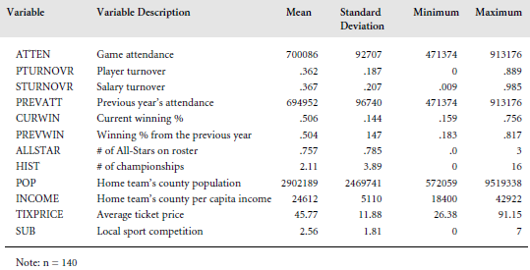
Descriptive Statistics

Slide 10
Results
NBA teams between the 2000- 2001 and 2004-2005 seasons
Average total home attendance of 700,086, with a standard deviation of 92,707.
About one-third of teams’ rosters changed each season.
Average player turnover of 36.2%
Average ticket price of all games in the sample was $45.76.
Seven of the 14 independent variables were significantly correlated to attendance at the 0.05 level.
It is important to note that neither measurements for roster turnover (player turnover and salary turnover) were significantly correlated with attendance.

Slide 11
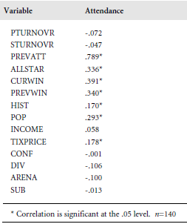
Variable Correlations with Attendance
Significant Variables include:
Previous year’s attendance
# of all-star players
Current winning percentage
Previous season’s winning percentage
# league championships won
Home county population
Average ticket price for a current season game

Slide 12
Censored Regression Analysis
140 observations
The censored regression model was found to be significant
Current winning percentage, previous winning percentage, population, and playing in a new arena were all positively related to attendance.

Slide 13
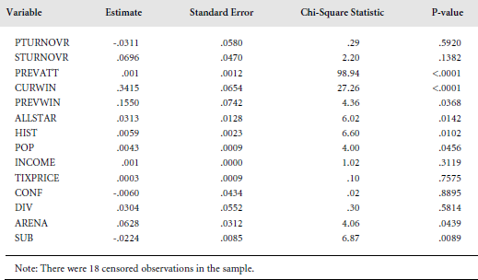
Censored Regression
Dependent Variable = Season Attendance

Slide 14
Censored Regression Analysis
Previous attendance explained the most variability in attendance.
High correlation between current and previous attendance.
Helped to examine the effect of roster turnover on the change in attendance from year to year.
Local sport competition was the only variable that had a significantly negative impact on attendance.
For each additional major professional sports team, local NBA team saw a decrease in attendance by about 2%.
This finding is consistent with recent research showing that NBA and minor league hockey teams saw an increase in attendance of approximately 2% during the NHL lockout in 2004-2005 (Rascher et al., in press).

Slide 15
Findings
The number of all-stars from the previous year that stay on the roster positively affects attendance.
Team history has a positive impact on attendance.
In general, roster turnover did not have a significant effect on attendance in the sample
This is contradictory to the results in the previous MLB study.
Taking the capacity constraints into account may have had an effect on the amount of variability explained by roster turnover in the censored regression model.
Population, income, and ticket price were not found to be statistically significant in the model.
These variables were all found to be significant in the MLB model

Slide 16
In the future…
Future research should be done on the role of roster turnover in other professional leagues as well
Look at the impacts of multiple teams in a franchise’s municipality and multiple “marquee status” players

Slide 17
Questions?
Thank you for your time and attention!

