Slide 1
The Value of Public Goods Generated by a Major League Sports Team: The CVM Approach
Michael Maldonado
BSPM 7220

Slide 2
Introduction
Majority of American major league sports stadiums in recent decades have received large government subsidies.
46 major league stadiums were built or renovated for teams between 1990 and 1998 and 49 sports building were under construction by the end of 1999.
Two thirds of the $21.7 billion spent on these buildings came from government sources.
Governments justify subsidies for buildings through the claim that teams generate large positive externalities.

Slide 3
Introduction (contd)
Two main external benefits that sports teams generate
They allegedly increase an area’s aggregate income through additional tourism. This includes increased spending on lodging, meals, and other travel and entertainment.
Some limited evidence suggests sports teams may reduce area income in certain cities.
Sports teams can produce public goods.
Local Unity, fan loyalty, and civic pride.
Street parties and demonstrations by fans after their team wins a championship.
Economists acknowledge that the cultural significance of sports most likely exceeds its business significance.

Slide 4
Value of public goods in sports.
The contingent valuation method (CVM) is applied to measure the value of public goods generated by major league sports teams.
The CVM is designed to measure the value of goods not traded in markets.
Traditionally used in environmental economic literature to measure value of environmental public goods (e.g. historical site preservation)
CVM was first applied through sports through two proposed projects in Lexington, KY.
New arena for UK basketball team
Minor league baseball stadium

Slide 5
CVM applied to major league sports
Pittsburgh Penguins
Penguins declared Ch. 11 bankruptcy in Oct. 1998.
U.S. Bankruptcy Judge Bernard Markovitz issued permanent injunction in March 1999 against any owners to discuss possible sale to owners who would move the franchise.
Potential buyers who would move the team to another city offered to buy the franchise for $85 million.
Judge Markovitz accept offer in June ‘99 from local investors to buy team for $65 million plus conversion of $20 million debt to retired Penguins player Mario Lemieux into equity.

Slide 6
Theory
Utility Function: u = u(x,h,z) where x is a vector of variables measuring the consumption of Penguins games, h is the existence of hockey in Pittsburgh, and z is a composite commodity of market goods.
Budget constraint: y = z+p’x where y is income and p is a vector of time and money costs of hockey game consumption.
Indirect utility function: u=v(p,h,y)
Expenditure function: e = e(p,h,u)

Slide 7
Theory
WTP = e(p’,0,u)-e(p,h,u) where p’ is price at which no games are consumed.
S = e(p’,0,v(p,h,y))-y
∂s/∂y = (∂e’/∂v)(∂v/∂y)-1=(∂e’/∂v)/(∂e/∂v)-1
If h is normal good, marginal cost of utility is lower and income effect is positive. If h is an inferior good the income effect is negative.
NUV = e(p”,0,v(p,h,y))-e(p’,h,v(p,h,y))
UV = e(p’,h,v(p,h,y))-y where UV is the difference between equations 2 and 4.

Slide 8
Survey
Section 1: Brief set of questions about professional football and baseball in Pittsburgh
Section 2: Questions regarding the consumption of Penguins hockey:
How many games attended at Civic Arena each season?
How many games do they watch on television?
How often do they read and discuss the team during the season?
Level of interest in the Penguins?
How would the quality of life be affected if the Penguins left?

Slide 9
Survey (cont’d)
Section 3: Valuation of Penguins hockey
Background information regarding Penguins bankruptcy and federal case
Respondents were asked whether keeping the Penguins in Pittsburgh is important and whether or not losing the team would hurt Pittsburgh’s image as a major city
Respondents were presented with scenario in which the team leaves the city
An alternative scenario is offered in which the team would become publicly owned at the cost of taxpayers:
“If the city of Pittsburgh were to buy the team, it would never leave Pittsburgh. But in order for the city to buy team, pay off its debts, and challenge for the Stanley Cup, taxpayer money will be needed. One estimate is that each Pittsburgh household would have to pay $TAX each year in higher city taxes.”
The four amounts for $TAX ($1, $5, $10, $25) were randomly assigned.

Slide 10
Survey (contd)
Discrete choice willingness question:
“Would you be willing to pay $TAX each year out of your own household budget in higher city taxes to help keep the Penguins in Pittsburgh?”
Open ended willingness question:
“What is the most you would be willing to pay out of your own household budget each year in higher city taxes to keep the Penguins in Pittsburgh?”
Zero
Between $0.01 and $4.99
Between $5 and $14.99
Between $15 and $29.99
Between 30 and $49.99
Between $50 and $75
More than $75
Why or why not?

Slide 11
Survey (contd)
Respondents were asked if they lived in Pittsburgh when the Penguins won the Stanley Cup in 1991 and 1992, and how they celebrated cup victories:
They did not watch or celebrate
They celebrated by consuming public goods (watched games at a sports bar, celebrated with friends, partied in the streets)
They celebrated by consuming private goods (attending Stanley Cup games in person)
Section 4: Impact of Pittsburgh area institutions on civic pride
Section 5: Demographics
Household size, gender, race, age, tenure in Western Penn., education, income.

Slide 12
Data
900 randomly selected households in Pittsburgh Metropolitan Statistical Area (MSA)
293 surveys returned for response rate of 35.6%
16 out of 200 windshield surveys returned.
Analysis uses the 226 surveys in which respondents answered every question but income.
Valuation and income questions create the greatest nonresponse.
When income questioned were not answered, income was estimated as a function of the demographic characteristics reported in the sample.
Average respondent was 52.4 years old whereas 59.7% of MSA population in ‘97 were younger than 45.
73% of sample were male compared to 48.1% of Penn. Population.

Slide 13
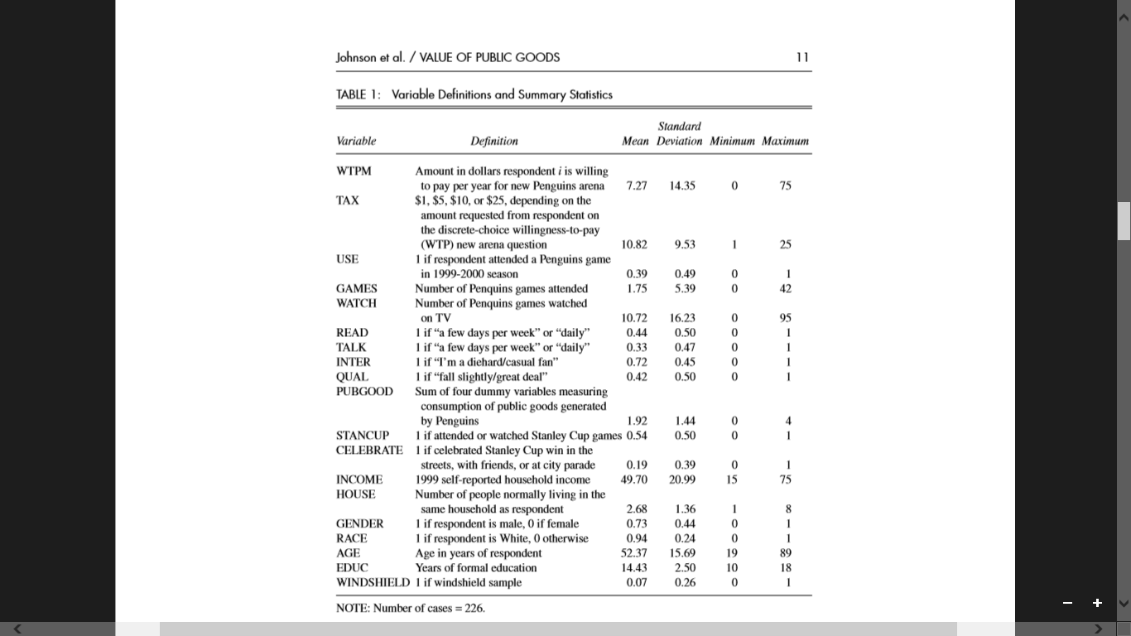

Slide 14
Empirical Model
WTP=f($TAX, INCOME, USE, GAMES, WATCH, PUBGOOD, STANCUP, CELEBRATE, WINDSHIELD, D)
WTP should increase with income if hockey is a normal good.
WTP should be higher for those who attend games and frequent attenders should be willing to pay more.
The more games watched, the higher WTP should be.
Nonuse value is calculated as the residual difference between WTP.
Use value is measure by setting USE and GAMES equal to zero.

Slide 17
Policy Implications
How well do the WTP estimates explain widespread support for the public subsidy of sports facilities?
WTP must be aggregated for the entire population
If aggregate WTP is interpreted as the annual flow of benefits generated by the team, the present discounted value of the stream future benefits can be interpreted as the capital value of the benefits generated by the team.
If capital value of public good generated exceeds subsidies paid to the team, the subsidy may be desirable to local politicians if team would otherwise not locate.
Politicians recognize that they will be rewarded in elections if they subsidize an arena.

Slide 19
Conclusion
The evidence from previous research that major league sports teams and stadiums do not generate increased income for cities along with the fact that public goods generated are not large enough to cover the public subsidies of stadiums, the public financing of sports buildings represent a misallocation of resources.
Caveats:
Hockey is the least popular of the four major league sports.
Analysis based only on data from Pittsburgh.

