Slide 1
Treatment of Travel Expenses by Golf Course Patrons: Sunk or Bundled Costs and the 1st and 3rd Law of Demand
Matthew T. Brown, Daniel A. Rascher, Chad D. McEvoy, Mark S. Nagel
Michael Brennan

Slide 2
Purpose of Study
The purpose of this study was to determine if golf tourists treated travel costs as sunk costs when deciding whether to play a great course or an average course or whether they treated travel costs as a bundled and thereby demanded great vacations as compared to average vacations. If travel costs are treated as sunk costs, by the first law of demand, golfers spending more on travel expenses will spend less on golf quality. However, if the third law of demand applies, golfers spending more on travel expenses will spend more for quality golf.

Slide 3
Background
Price, course type, style, location, and number of holes are factors affecting the choice of where to play.
Example: 2 courses located in same community. Course A costs $50, Course B costs $100.
Locals:
More likely to play course A than B, and play course A more often than B.
Have to pay 100% more to have a great golf day (course B) rather than an average golf day (A)
Tourists: Assume $200 of travel costs for coming from a distance
Great golf vacation would cost $300 total (playing at course B)
Average golf vacation would cost $250 total (playing at course A)
Have to pay only 20% more to have a great golf vacation
Based on the Alchian-Allen Theorem, an assumption can be made that tourists are more likely to pay to play course B as compared to the local because of the lower relative cost.

Slide 4
Alchian-Allen Theorem
Developed by Armen Alchian and William Allen
When a fixed cost is added to the price of two products, the more expensive product becomes cheaper relative to the less expensive product leading to increased consumption of the more expensive product.
Examples:
Grapes in CA and NY – Alchian and Allen, fixed transportation costs
Lobsters in Maine – Borcherding and Silberberg, transportation by consumer
Clemson Football – Bertonazzi, further distance traveled = more expensive tickets, support for Borcherding and Silberberg
Vacation Packages – e.g, Alchian Allen would only apply to golf if a strong positive correlation between high quality golf and a high quality vacation

Slide 5
Treatment of Travel Costs as Sunk Costs
Cost that has already been incurred and cannot be recovered
Course quality purchase decision separate from the travel cost decision
I.e. Once the golfer arrives in the community, he/she can pay half the price to play on course A
In the case of A and B with travel costs treated as sunk costs and separated, the price of B ($100) is twice as much as A ($50) and the utility gained from playing on course B is twice as much as utility gained from playing course A.
Ratio of Prices – A/B = 50/100 = .50
Sunk costs would mean that the utility maximizing solution would be to play an equal amount of rounds on course A and course B.

Slide 6
Treatment of Travel Costs as Bundled Costs
Golf consumers purchase golf vacations with the travel costs bundled with other costs including the cost of playing the round.
Assuming $300 in travel costs, a great golf vacation (course B) would cost a total of $400 and an average golf vacation would cost a total of $350 (course A).
Ratio of Prices – A:B = 350/400 = .875
As the cost of the higher quality course (B) decreases relative to the cost of the average course (A), in order to maximize utility, more games would have to be played at the more expensive course (B).
Locals: lower travel and other costs – more games on A
Tourists: higher travel and other costs – more games on B

Slide 7
Purpose of Study
For the golf consumer, the costs of travel and quality can be separated. The issue, and main question of the study, is whether or not they will be.

Slide 8
Methodology
Spending of golfers within the state of Ohio analyzed
Higher price = higher quality course and vice versa for purpose of this study
Divided golf courses into 5 geographical regions within Ohio and drew a sample of 45 random courses
On various dates, contact information cards were given to each course in the sample and subsequently given to golfers
The cards directed the golfers to a survey in which they were asked about the course, their hometown, distance they traveled, and cost of play and other activities
Correlations examined between distance traveled and expenses:
Green fee, cart fee, total green/cart fee, total on course expenses, total off course golf related spending, and total trip spending.

Slide 9
Results
376 total responses, 56% response rate
35 total tourists – living 100+ miles out of state
Total Golfers
Significant positive correlations (α = .01): between distance traveled and green fee, green/cart fee, total course spending and total trip spending
Tourists
Significant positive correlations (α = .01): between distance traveled and green fee, green/cart fee, and total trip spending.
Significant positive correlations (α = .05): between distance traveled and cart fee and total course spending

Slide 10
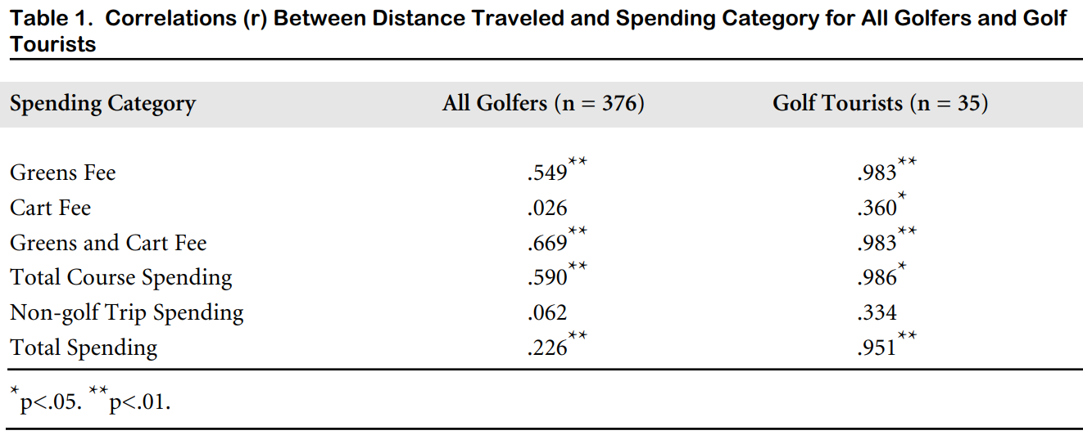
Results

Slide 11
Conclusion
The Alchian-Allen Theorem was supported by the results
Correlations are especially strong with regard to the green fee, green/cart fee, total course spending, and total trip spending for tourists – all > .950
Tourists are more likely to pay higher prices for green fees – bundled costs
Local golfers are also likely to pay higher prices based on longer distance traveled, though not as strong of correlation as tourists
In terms of the local and tourist golf population in Ohio, most golfers, especially tourists, will bundle intermediate costs with the quality costs.

Slide 12
Conclusion
How can golf course managers use this study?
Market segmentation and Target Marketing:
Higher price courses – target tourists through golf magazines
Lower price courses – target local golfers
Vacation Packages:
Tourism officials should bundle high quality golf (more expensive) with higher quality vacation packages and market to vacationers coming from a distance

Slide 13
Questions?

