Slide 1
Markov Chains
Part 4

Slide 2
The Story so far …
Def: Markov Chain: collection of states together with a matrix of probabilities called transition matrix (p_{ij}) where p_{ij} indicates the probability of switching from state S_{i} to state s_{j}
Theorem 1: The p_{ij} entry of P^{n} shows the prob of moving from state s_{i} to state s_{j} in n steps
Theorem 2: If u is a vector of starting probabilities, then the probability of being in state s_{j} after n steps is u^{(n)} = u P^{n}

Slide 3
The Story so far … (2)
Def: A state s_{j} of a Markov chain is called absorbing if you cannot leave it, i.e. p_{ii} = 1. A Markiv chain is absorbing if it has at least one absorbing state and it is possible to reach that absorbing state from any other state. In an absorbing Markov chain the state that is not absorbing is called transient.
Note: The canonical form of a transition matrix of an absorbing Markov chain has the form
Theorem 3: In an absorbing Marko chain the probability of a process being absorbed is 1, i.e Q^{n} → 0
Q | R
0 | Id

Slide 4
The Story so far … (3)
Theorem 4:For an absorbing Markov chain P, the matrix N = (I − Q)⁻¹ is called the fundamental matrix for P. The entry n_{ij} of N gives the expected number of times that the process is in the transient state s_{j} if it started in the transient state s_{i}
Example: Find the expected number of times in states 1, 2, and 3 before being absorbed in our drunkard’s walk with 4 corners.

Slide 5
Are we there yet …?
Theorem 5 (Time to Absorption): Let t_{i} be the expected number of steps before the chain is absorbed, given that the chain starts in state s_{i}, and let t be the column vector whose ith entry is t_{i}. Then
t = Nc
where c is a column vector all of whose entries are 1.
Example: Find the time to absorption in our drunkard’s walk.

Slide 6
Are we there yet … (2)
Theorem 6: Let b_{ij} be the probability that an absorbing chain will be absorbed in the absorbing state s_{j} if it starts in the transient state s_{i}. Let B be the matrix with entries b_{ij} . Then B is an t-by-r matrix, and B = NR , where N is the fundamental matrix and R is as in the canonical form.
Example: Find and interpet the matrix B or ou drunkard’s walk.

Slide 7
Summary
The properties of an absorbing Markov chain are described by the transition matrix P as well the matrices Q, R, N, t, and B.
Example: Find Q, R, N, t, and B for the pizza delivery Markov chain.

Slide 8
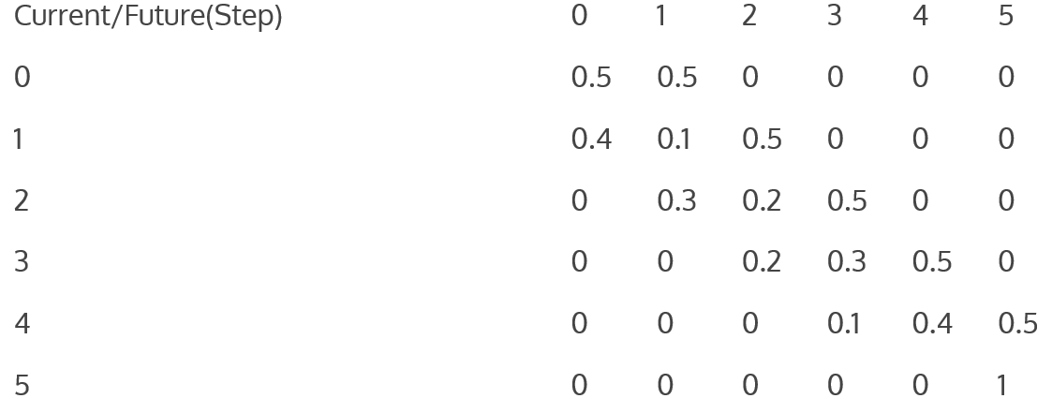
Canonical Form of “Pizza” Transition Matrix

Slide 9
Ergodic Markov Chains
Definition: A Markov chain is called ergodic if it is possible to go from every state to every state (not necessarily in one move). In many books, ergodic Markov chains are called irreducible.
A Markov chain is called regular if some power of the transition matrix has only positive elements. In other words, for some n, it is possible to go from any state to any state in exactly n steps.
Is every regular chain ergodic?
Is every ergodic chain regular?
Is an absorbing chain regular or ergodic?

Slide 10
Ergodic does not imply Regular
Example: Consider the transition matrix P = $\left(\begin{matrix}0 & 1 \\ 1 & 0\end{matrix}\right)$. This Markov chain is ergodic but not regular.
How about the “Ehrenfest urn” model, whose transition matrix is:
$$\left(\begin{matrix}0 & 1 & 0 & 0 & 0 \\ 1/4 & 0 & 3/4 & 0 & 0 \\ 0 & 1/2 & 0 & 1/2 & 0 \\ 0 & 0 & 3/4 & 0 & 1/4 \\ 0 & 0 & 0 & 1 & 0\end{matrix}\right)$$
How about if you change any zero in the above matrix to a non-zero entry? For that matrix, compute P^n as n goes to infinity.
This is no accident, as the next theorem shows.

