Slide 1
Markov Chains
Part 3

Slide 2
Sample Problems
Do problems 2, 3, 7, 8, 11 of the posted notes on Markov Chains

Slide 3
Pizza Delivery Example

Slide 4
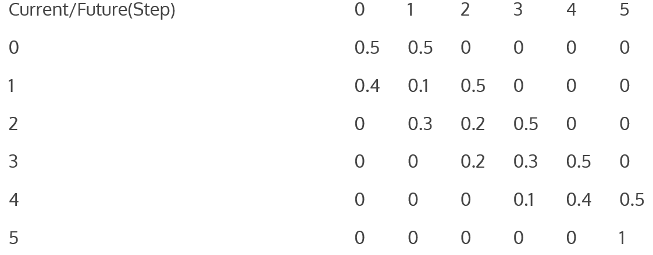
Pizza Delivery Example

Slide 5
Will we get Pizza?
Start with s = <1, 0, 0, 0, 0, 0>. Find s = s P n-times.

Slide 6
Transient vs Absorbing
Definition: A state s_{i} of a Markov chain is called absorbing if it is impossible to leave it (i.e., p_{ii} = 1).
Definition: A Markov chain is absorbing if it has at least one absorbing state, and if from every state it is possible to go to an absorbing state (not necessarily in one step).
Definition: In an absorbing Markov chain, a state which is not absorbing is called transient.

Slide 7
Questions to Ask about a Markov Chain
What is the probability that the process will eventually reach an absorbing state?
What is the probability that the process will end up in a given absorbing state?
On the average, how long will it take for the process to be absorbed?
On the average, how many times will the process be in each transient state?

Slide 8
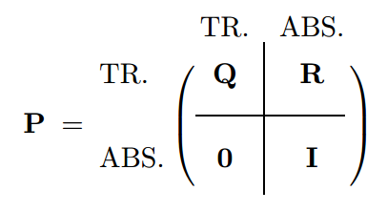
Canonical Form
Consider an arbitrary absorbing Markov chain. Renumber the states so that the transient states come first. If there are r absorbing states and t transient states, the transition matrix will have the following canonical form.
Here I is an r-by-r indentity matrix, 0 is an
r-by-t zero matrix, R is a nonzero t-by-r
matrix, and Q is an t-by-t matrix. The first t
states are transient and the last r states are
absorbing.

Slide 9
Canonical Form of “drunkard’s” Transition Matrix

Slide 10
Canonical Form of “drunkard’s” Transition Matrix

Slide 11
Canonical Form of “Pizza” Transition Matrix

Slide 12
All Transient States will get Absorbed
Theorem
In an absorbing Markov chain, the probability that the process will be absorbed is 1. Equivalently, Q^{n} goes to 0 as n goes to infinity.
Verify this theorem
(a) For the pizza delivery
(b) for the drunkard walk

Slide 13
Fundamental Theorem
Theorem
For an absorbing Markov chain the matrix I − Q has an inverse N and N = I + Q + Q² + ··· . The ij-entry n_{ij} of the matrix N is the expected number of times the chain is in state s_{j} , given that it starts in state s_{i}. The initial state is counted if i = j.
Definition
For an absorbing Markov chain P, the matrix N = (I − Q)⁻¹ is called the fundamental matrix for P

Slide 14
How long in each transient state?

Slide 15
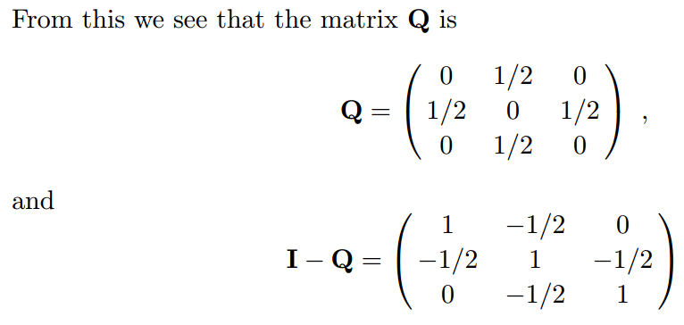
How long in each transient state?

Slide 16
How long in each transient state?

Slide 17
Fundamental Matrix
Find the Fundamental Matrix for the Pizza Delivery process

