Slide 1
Robotics and EVT - line follower -
Bert Wachsmuth
Math and Computer Science
Seton Hall University

Slide 2
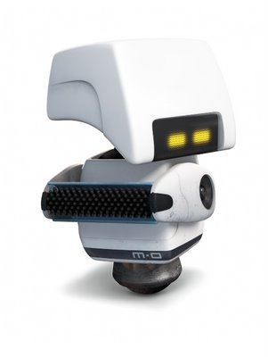
Task: Follow the Yellow Brick Road
Suppose you have a differential drive robot with a light sensor in front, facing down.
Put the robot on a black line on white background and program it to follow that line indefinitely.

Slide 3
Task: Follow the Yellow Brick Road
Assume: start on “gray” between, with black on the left, white on the right!!
if (solid black)
curve right
else if (gray)
go straight
else if (white)
curve left

Slide 4
PID Controller
Proportional-Integral-Derivative controller: most commonly used feedback controller (closed loop)
Proportional value P determines the reaction to the current error.
P depends on the present error
Integral value I determines the reaction based on the sum of recent errors.
I depends on the accumulation (sum) of past errors
Derivative value D determines the reaction based on the rate at which the error has been changing.
D is a prediction of future errors based on current rate of change
Change your Line-Follower algorithm to a proportional algorithm

