Slide 1
Introduction to Robots and the Mind - Programming Basics -
Bert Wachsmuth & Michael Vigorito
Seton Hall University

Slide 2
Programming
“Creating a sequence of instructions to enable the computer/robot to do something”
http://wordnetweb.princeton.edu/perl/webwn?s=computer programming
Create the program , i.e. the sequence of instructions. Most spoken languages are full of ambiguities, so we use a special language instead, such as Java (or C++, Perl, Scheme, Python, or …)
Need to learn the grammar and vocabulary of our special language of choice (Java)
Translate the program into instructions that the computer processor can understand (handled by IDE)
Execute instructions (handled by IDE) and test program!

Slide 3
Basic Grammar of Java
A (Java) program is a sequence of statements, one per line
Java is case-sensitive, i.e. the word “LCD” and “Lcd” are considered different.
A valid Java statement must end with a semi-colon ; unless it starts a group.
Java uses three sets of parenthesis/brackets:
curly brackets “{ … }” to group statements together
regular parenthesis “(…)” to denote inputs to functions and for math expressions
square brackets “[ … ]” to denote what’s called arrays

Slide 4
Basic Grammar of Java
Every (almost) Java program has a unique program name and includes as a minimum the following lines, known as the standard framework:
public class ProgramName
{
// Comments start with // and comment on the code
// in plain English
public static void main(String[] args)
{
⬅ here goes your Java code
}
}

Slide 5
A Complete Robot Program
public class MakeSound {
public static void main(String[] args) {
// TODO Auto-generated method stub
}
}

Slide 6
A Complete Robot Program
public class MakeSound
{
public static void main(String[] args)
{
// TODO Auto-generated method stub
}
}

Slide 7
A Complete Robot Program
public class MakeSound
{
public static void main(String[] args)
{
// play standard “A” for 1.5 seconds
Sound.playTone(440, 1500);
}
}

Slide 8
Fixed EV3 Components
The EV3 brick includes many named components such as LCD, Button, Sound, etc.
Programming those is easy: use them by name and call on their built-in functions using the syntax
Component.function(optional input)
Note: in proper Java lingo such functions are called static methods

Slide 9
The “Sound” Component
The Sound component supports the following static methods to generate music:
Sound.beep()
Sound.beepSequence()
Sound.beepSequenceUp()
Sound.buzz();
Sound.pause(millisecs)
Sound.playTone(freq, duration)
Sound.playSample(File filename)

Slide 10
Your first “Challenge”
Create and execute a program that plays a short melody or song. Any melody with three notes or more will do, but you will get special credit for playing some well-known melody such as “Beethoven’s Fifth”

Slide 11
Robot Teams
Francisco Arocho, Malik Dye, and Brian Wreckler Joelle Arrante and Onyinyechukwu Okeke Tiffany Callanan, Kenneth E. Cherasia, and Isabell Klingert Luis Cerqueira and Darren Lesinski Zachary Darby and David T Rivella Dominick Defrenza, and Jonathan Roan Vincent Latorraca and John Stratoberdha Jessica Melnyczuk and Jenyffer Santiago Jamie Porteus and Gerard Rangel James Prumos and Sean Sullivan

Slide 12
Working with Motors
Working with motors is in principle similar to generating a tone but the setup is a little more complicated because a motor could be connected to A, B, C, or D
Connect one of the large motors to one of the output ports A, B, C, and D

Slide 13
Fields and Methods
Every Java class (aka program) can contain:
fields: references for everything a robot “has”
methods: functions that specify what a robot “does”
public class SampleProg
{ // fields to reference what robot “has”
private static Sensor lightSensor;
// methods to specify what robot “does”
public static void driveForward()
{ // method to make robot drive forward
}
public static void main(String[] args)
{ // default ‘main’ method
}
}

Slide 14
Sample program
import lejos.hardware.motor.EV3LargeRegulatedMotor;
import lejos.hardware.port.MotorPort;
public class RunMotor
{ // fields
public static EV3LargeRegulatedMotor motor =
new EV3LargeRegulatedMotor(MotorPort.A);
// methods
public static void motorForward()
{
motor.rotate(360);
}
public static void motorBackwards()
{
motor.rotate(-360);
}
public static void main(String[] args)
{
motorForward();
motorBackwards();
}
}

Slide 15
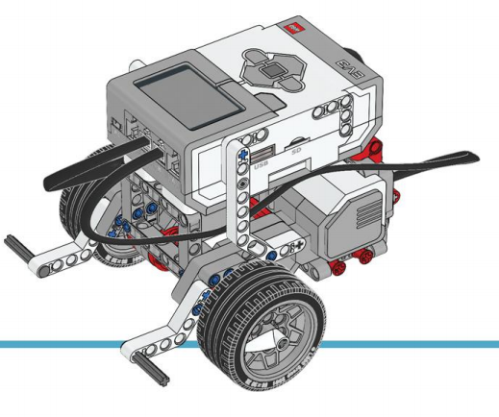
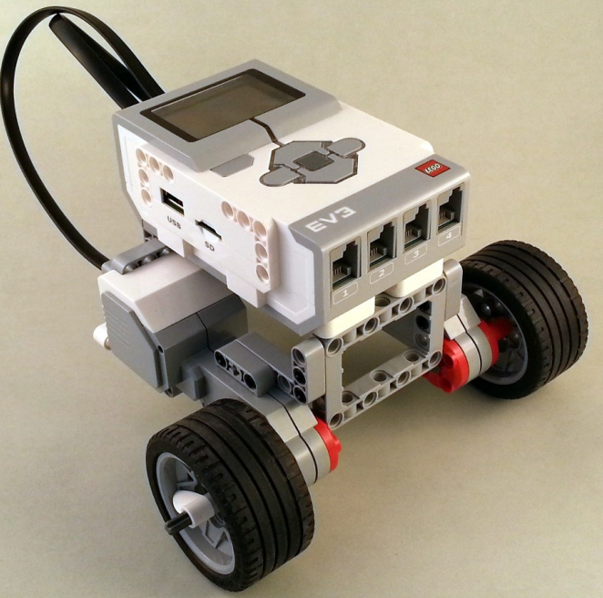
Building a Simple Driving Robot
Build one of these robots (click for blueprints or visit our web page)

Slide 16
Programming our Robot (1)
To design any program, we ask:
What does the robot have?
What is it supposed to do?
It has: left and right motor
we need two fields of type ‘motor’ with different names
It needs to do: drive and turn
we need two methods (in addition to the standard main method)

Slide 17
Programming our Robot (2)
public class MyFirstRobot
{ // fields
public static EV3LargeRegulatedMotor motorLeft =
new EV3LargeRegulatedMotor(MotorPort.A);
public static EV3LargeRegulatedMotor motorRight =
new EV3LargeRegulatedMotor(MotorPort.D);
// methods
public static void turn()
{}
public static void drive()
{}
public static void main(String[] args)
{ }
}

Slide 18
Programming our Robot (3)
public static void turn()
{
motorLeft.rotate(360, true);
motorRight.rotate(-360);
}
public static void drive()
{
motorLeft.rotate(360, true);
motorRight.rotate(360);
}
public static void main(String[] args)
{
drive();
turn();
}
b

Slide 19
Programming our Robot (4)
Issues left to fix and/or improve
turn method should turn 90 degrees
drive method should drive 50 cm
Need more flexibility in turn and drive methods to solve second challenge
turn method should have an input to specify how many degrees to turn
drive method should have an input to specify how many cm to drive forward

Slide 20
Homework
Create program with a drive and turn method and test them.
Next Challenge (for next Wed): Adjust the main method so that your robot drives in the shape of some geometric pattern (square, rectangle, triangle, pentagon, Star of David, etc) and returns to the spot where it started

