Slide 1
Introduction to Robots and the Mind
Bert Wachsmuth & Michael Vigorito
Seton Hall University

Slide 2
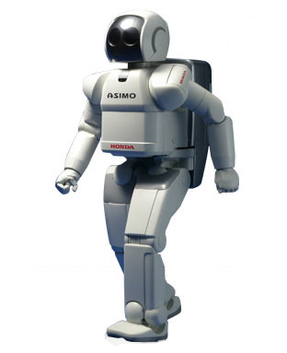
Robots &
the Mind
Bert Wachsmuth Math & CS
Algorithms and Program design
Programming in Java
Building Robots
Sensor feedback
Behavior-based robots
Robots that learn
Michael Vigorito Psychology
Science and Catholic thought
Neuroscience
Evolution & natural selection
Sensation and perception
Adaptive behavior and learning

Slide 3
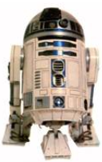
What is Robotics
Robotics is the science and technology of robots, their design, manufacture, and application.
Robotics is at the intersection of multiple disciplines
A person working in the field is a roboticist.
http://www.edinformatics.com/math_science/robotics/robotics1.htm

Slide 4
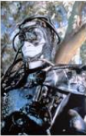
“Robot” Portion
Programming and Building Robots at
http://pirate.shu.edu/~wachsmut/
Sample Challenges
Self-driving car
Move like an Ant
Rescue Mission
Solving a Maze
Learning Robot
Battle Bots

Slide 5
Solving a Maze
Video from https://youtu.be/8L_OvprbBVM - click image to start

Slide 6
Robot Battle (Battle Bots)
Embedded video - click image to start

Slide 7
Real (and deadly) Battle Robs

Slide 8
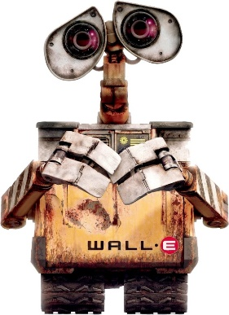
DARPA Robotics Challenge (DRC)
DRC Finals took place in California in June, 2015. Twenty-five of the top robotics organizations in the world competed for $3.5 million in prizes.
The Challenges
Drive a utility vehicle at the site.
Travel dismounted across rubble.
Remove debris blocking an entryway.
Open a door and enter a building.
Climb an industrial ladder and traverse an industrial walkway.
Use a tool to break through a concrete panel.
Locate and close a valve near a leaking pipe.
Connect a fire hose to a standpipe and turn on a valve.

Slide 9
DARPA Robotics Challenge

Slide 10
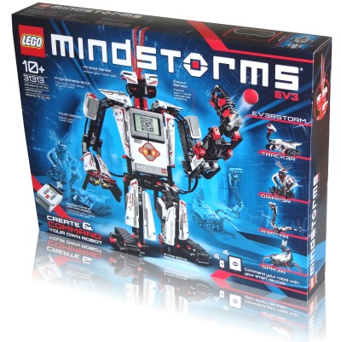
Logo Mindstorm EV3
EV3 Intelligent Brick
ARM9 CPU with Linux OS
16 MB Flash, 64 MB RAM
4 input & 4 output ports
microSD & Bluetooth
LCD display, Speaker
3rd generation (RCX, NXT, EV3)
3 servo motors & integrated rotation sensors
Sensors: touch, color, ultrasound, gyro
Contains about 550 parts

Slide 11
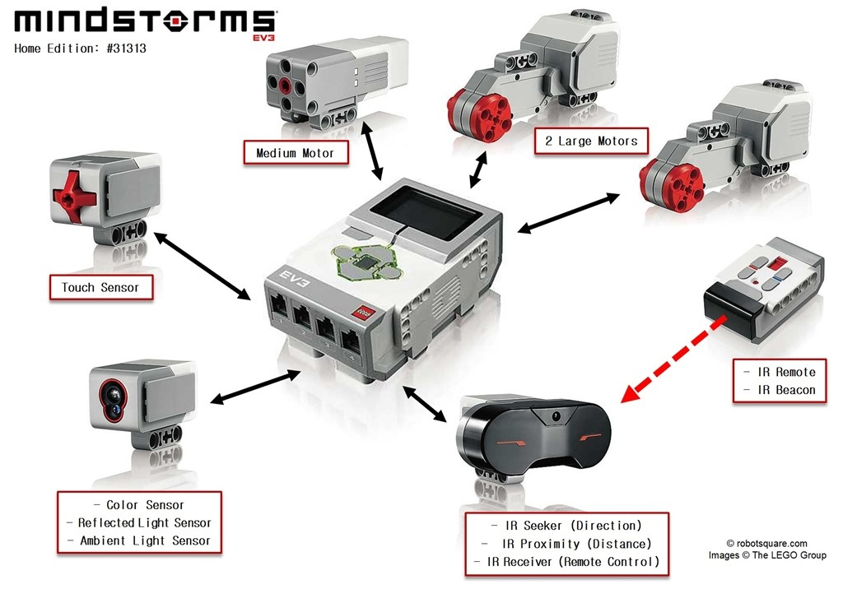
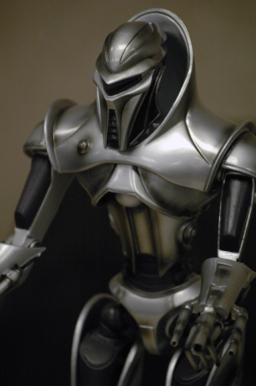
EV3 “smart” components

Slide 12
Robots for All
Form teams of two or three students
One EV3 robot kit per team (responsible for each of the 600 parts)
Bring kit (fully charged) to each class unless told otherwise
All challenges are team efforts and are graded as such
One week per challenge (might require team meetings outside class)
Each team must demonstrate in class how their robot solves a challenge

Slide 13
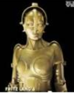
A “Program”
Sequence of instructions to tell robot what to do:
Written by humans in a programming language
Translated by a compiler to machine language
Uploaded to robot's processor
Executed by robot step by step

Slide 14
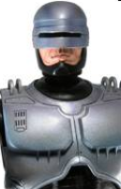
Programming Background
NONE needed (yay)
Programming language used: Java
All instructions provided online
No book necessary …
… but we do need special software

Slide 15
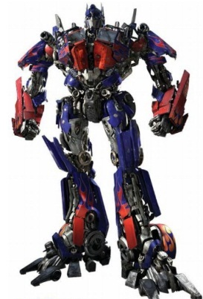
Programming Necessities
Editor to write the program
Compiler to translate the program
Uploader to transfer the program
Robot to execute the program

Slide 16
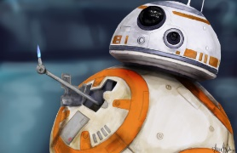
How to get the Software
http://pirate.shu.edu/~wachsmut =>
CSAS 3085 => Get required software
JDK (Java Developer Kit)
Eclipse IDE (Integrated Developer Environment)
LeJOS (Lego Java Operating System)
Homework
Download and configure the software
Send email about team member(s)
Identify all robots in the lower-left portion of each slide (to determine your geek coefficient)

