Slide 1
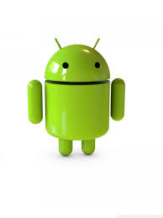
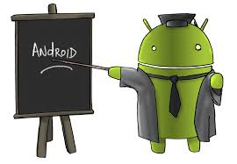
Android
Bert Wachsmuth Seton Hall University

Slide 2
Android in a Nutshell
Android is a Linux-based mobile phone operating system developed by Google*
Android is open source; Google releases the code under the Apache License; source code will only run on select devices (Nexus line)
Google is actively developing the platform but gives it away for free to hardware manufacturers
Google needs to certify that a device complies with their Compatibility Specs before it can use Google's Android trademark.
Devices must also meet the specs to license Google's closed-source applications, including Google Play
(*) Initially developed by Android, Inc., which Google backed financially and bought in 2005

Slide 3
Android by the Numbers
Android's share of global smartphone market: 64% (03/2013)
Number of models of Android devices: 11,868 (07/2013)
Apps installed from the Google Play store: 48 billion (03/2013)
Android devices activated: 1 billion (09/2013)
Scores of screen sizes and eight OS versions are simultaneously in use
Source: http://en.wikipedia.org/wiki/Android_(operating_system)

Slide 4
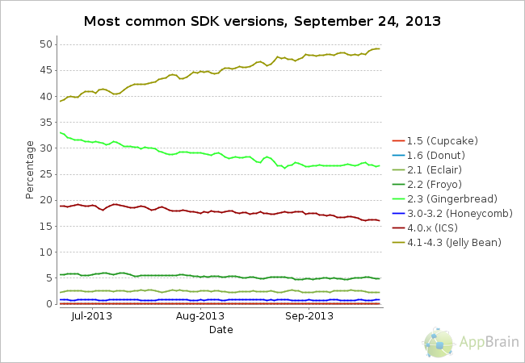
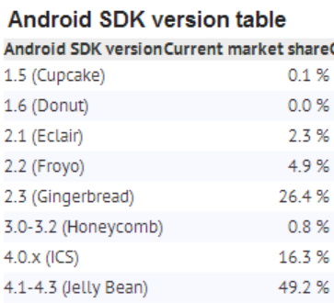
Current Android Versions

Slide 5
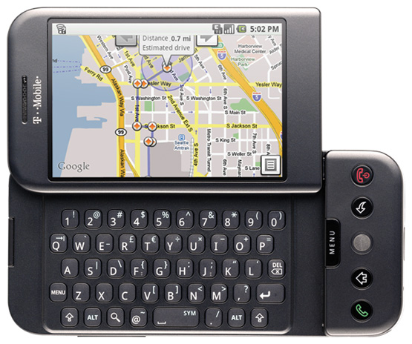
Android is now 5 Years Old
The first publically available Android device was the HTC Dream, also known as the G1, on T-Mobile on October 22nd, 2008
Source: http://www.theverge.com/2011/12/7/2585779/android-history

Slide 6
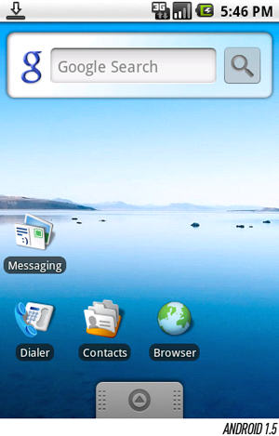
Android 1.5 - Cupcake
An on-screen keyboard
Extensible widgets
Video capture and playback
Clipboard improvements

Slide 7
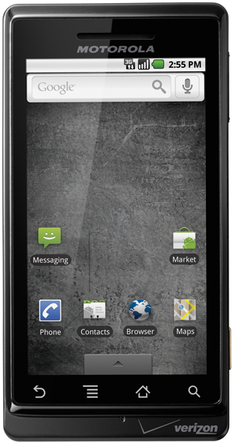
Android 2.0/2.1 - Eclair
Huge marketing campaign by Verizon for the “Droid”
854 x 480 display (and many other resolutions)
Google Maps Navigation
Revamped browser
Speech-to-text
A new lock screen

Slide 8
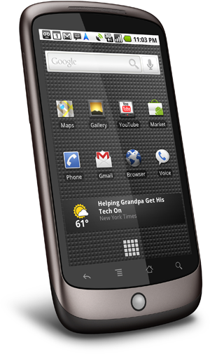
Android 2.2/2.3 - Gingerbread
An improved keyboard
Better battery and app management tools
Support for front-facing cameras
Google Nexus Line: Nexus One and Nexus S

Slide 9
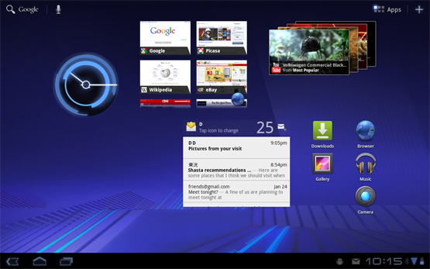
Android 3.0 - Honeycomb
Support for tablets (large screens)
Switch to “blue” (from “green”)
Removal of physical buttons
Better Multitasking

Slide 10
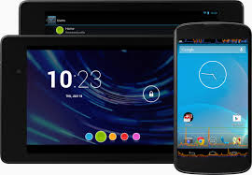
4.0 – Ice Cream Sandwich 4.1/2/3 – Jelly Bean
New calendar and mail apps
Google Now
Voice dictation
Roboto (Font) refresh
Predictive text
NFC support
Photospheres
Accessibility enhancement
Expandable, "actionable" notifications
Redesigned clock app and clock widgets
Google Nexus 4 (by LG)

Slide 11
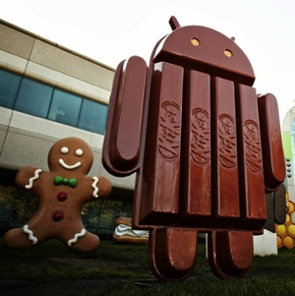
Android 4.4 – KitKat
?
Google Nexus 5

