Slide 1
Redistribute?
David Brooks, writing in the New York Times (Oct 2014) in his column “The Working Nation“:
Today, too many people are focused on the top 1 percent. But, as economist David Autor has shown, if you took all the wealth gains the top 1 percent made between 1979 and 2012 and spread it to the bottom 99 percent, each household would get a payment of only $7,000. But if you take a two-earner, high-school-educated couple and get them college degrees, their income goes up by $58,000 per year. Inequality is mostly a human capital problem.
Kurt W. Rotthoff
Notes:
Content Slide 1

Slide 2
Movement
Most working Americans who were initially in the bottom 20% of income-earners, rise out of that bottom 20%. More of them end up in the top 20% than remain in the bottom 20%. People who were initially in the bottom 20% in income have had the highest rate of increase in their incomes, while those who were initially in the top 20% have had the lowest. This is the direct opposite of the pattern found when following income brackets over time, rather than following individual people.
Video
Kurt W. Rotthoff
Notes:
Content Slide 1

Slide 3
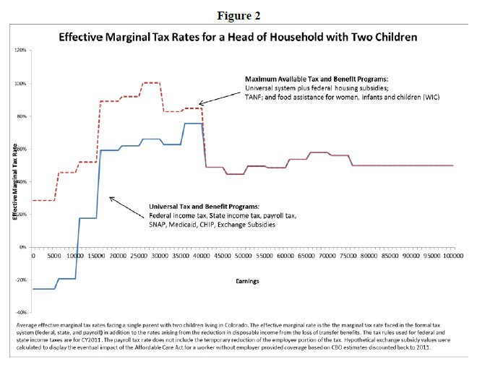
Sports Franchises
Kurt W. Rotthoff
Notes:
Content Slide 1

Slide 4
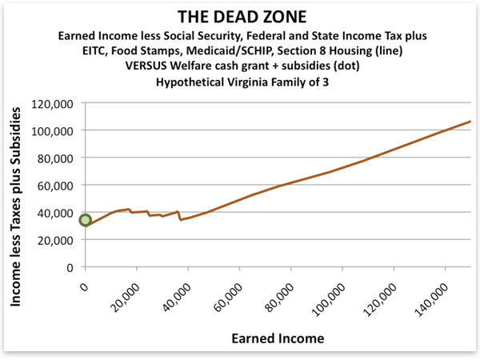
Sports Franchises
If we build it, will the jobs come?
Kurt W. Rotthoff
Notes:
Content Slide 1

